Slide 1
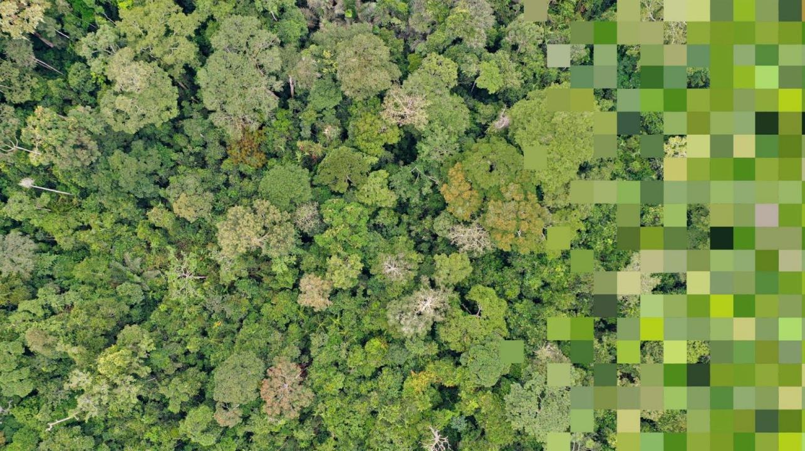


PANGEA
PAN tropical investigation of bioGeochemistry and Ecological Adaptation
Scoping a NASA Terrestrial Ecology Field Campaign
December 11, 2023 – AGU Annual Meeting Town Hall

Slide 2
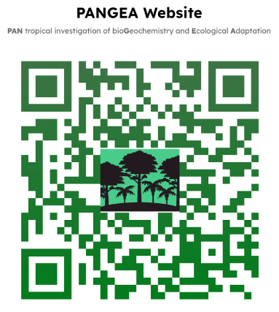
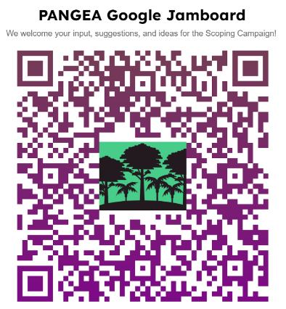


Agenda
PANGEA overview
What is a NASA Tropical Ecology Field Campaign?
How do we scope it?
Past NASA campaigns
How to get Involved
Discussion and Questions
Important Links
PANGEA Website
Google Jamboard
PANGEA - NASA Terrestrial Ecology Field Campaign Scoping Study
Notes:
This meeting will be recorded. We will also make the transcript available in multiple languages and put all of that information on the website.

Slide 3

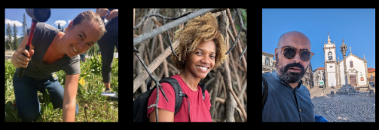
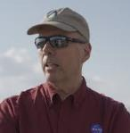



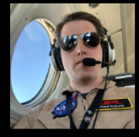

Leadership Team
Isaac Aguilar
UCLA
Dana Chadwick JPL
Lola Fatoyinbo
NASA Goddard
António Ferraz
UCLA / JPL
Peter Griffith
NASA Goddard
Michael Keller
USFS
Junjie Liu
JPL
Chip Miller
JPL
Elsa Ordway (PI)
UCLA
Ryan Pavlick
JPL
Fabian Schneider
JPL
Bonaventure Sonké
Univ. of Yaoundé I
Hannah Stouter
UCLA
Xiangming Xiao
Univ. of Oklahoma
PANGEA - NASA Terrestrial Ecology Field Campaign Scoping Study
Notes:
Want to acknowledge that this scoping effort is very much a team effort. We have an incredible leadership team that brings a great deal of expertise from NASA campaigns past and present. You’ll hear from some of these folks today.

Slide 4

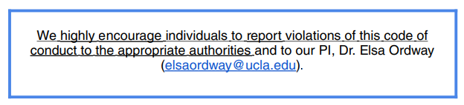
Community Guidelines
To ensure an inclusive and equitable environment for all members, we have established a set of guidelines to be followed at all times during the Tropical Forest Scoping effort, including at workshops, during webinars, and when using email, Slack, and other modes of communication. These guidelines are designed to promote respect and collaboration among community members. By adhering to these guidelines, we aim to create a welcoming space where everyone can thrive.
PANGEA - NASA Terrestrial Ecology Field Campaign Scoping Study
Notes:
These were derived from UCLA + NASA policies and reporting requirements – These are meant to be updatable and we’ll will gather community input to update them as we grow our tropical scoping community.

Slide 5
Tropical forest regions are critically important
Tropical ecosystems:
Cover 10% ice-free land surface
Maintain 66-80% of all species
Are home to over 3 billion people
Constitute major water and heat pumps, contributing to regional and global climate
Account for >30% of terrestrial NPP
Store 25-40% of total terrestrial biomass
PANGEA - NASA Terrestrial Ecology Field Campaign Scoping Study

Slide 6
Tropical forest regions are undergoing rapid change
Tropical ecosystems are entering a no-analog state
Temperatures will soon be hotter than most tropical ecosystems have experienced in their evolutionary history (range shifts, adaptation, acclimation?)
Cropland and pastureland expansion in the tropics is the single greatest driver of deforestation, causing ~80% of forest conversion globally
Tropical structure and function could be greatly diminished by the end of the century, resulting in critical climate feedbacks
Even though tropical forests have a huge impact on the entire Earth System, we still lack basic knowledge about them
PANGEA - NASA Terrestrial Ecology Field Campaign Scoping Study

Slide 7
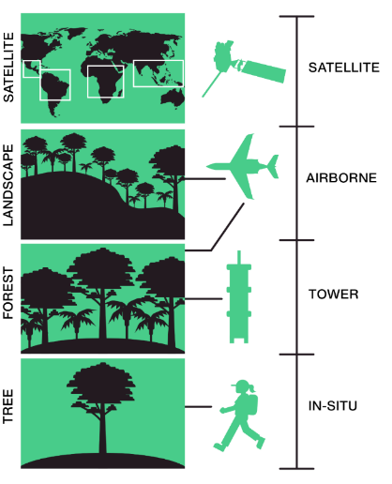
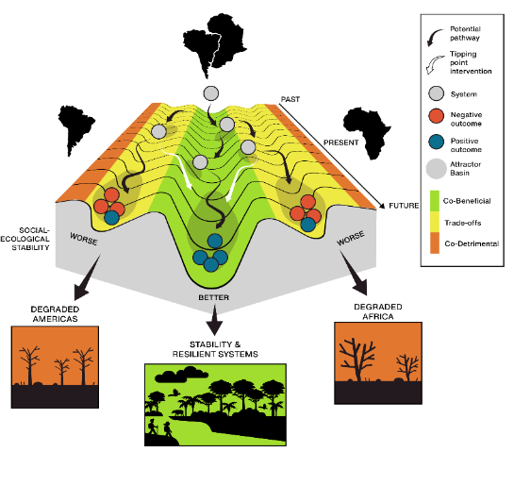
What is PANGEA?
REGION
SPACEBORNE
LANDSCAPE
AIRBORNE
FOREST
TOWER
TREE
IN SITU
PANGEA - NASA Terrestrial Ecology Field Campaign Scoping Study

Slide 8
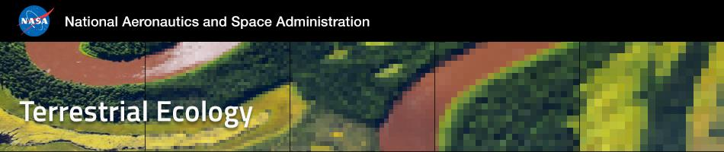

What is a NASA Terrestrial Ecology (TE) Field Campaign?
Hank Margolis, Program Officer at NASA Headquarters
Terrestrial Ecology, Carbon Monitoring System
PANGEA - NASA Terrestrial Ecology Field Campaign Scoping Study

Slide 9
What is a NASA Terrestrial Ecology (TE) Field Campaign?
A large-scale research and capacity building effort to better understand how Earth’s tropical terrestrial ecosystems are responding to global change.
  Multi-scalar
    Surface, airborne, and spaceborne observations
    Local to global ramifications & engagement
  Interdisciplinary
    Ecology, Biogeochemistry, Hydrology, Atmospheric Sciences, Socio-Ecological Systems, and more
PANGEA - NASA Terrestrial Ecology Field Campaign Scoping Study

Slide 10
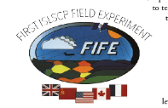
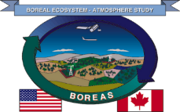
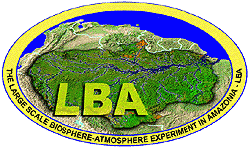

Past NASA TE Field Campaigns
FIFE: First International Satellite Land Surface Climatology Project (ISLSCP) Field Experiment (1987-1989)
BOREAS: Boreal Ecosystem-Atmosphere Study (1992-1999)
LBA: Large-scale Biosphere-Atmosphere Experiment in Amazonia (1998-2011)
ABoVE: Arctic Boreal Vulnerability Experiment (2015-2024)
PANGEA - NASA Terrestrial Ecology Field Campaign Scoping Study

Slide 11
What does it mean to scope a TE field campaign?
A one-year effort to engage with the research community to:
  Identify scientific research priorities and opportunities
  Build relationships and define shared goals
  Determine the geographic scope
  Evaluate campaign feasibility
Only 2 scoping proposals funded – PANGEA and ARID
Deliver white paper reporting findings by Dec 2024
If campaign funded, 6- to 9-year campaign
PANGEA - NASA Terrestrial Ecology Field Campaign Scoping Study

Slide 12
PANGEA Scoping Timeline
AGU Town Hall
c
Asia Regional Consultation
Writing workshop
Kick-off webinar
Africa Regional Consultation
Community workshop
Americas Regional Consultation
Webinar + Feedback
White paper to NASA
Working groups
Community engagement
Nov 2023
Jan 2024
Mar 2024
May 2024
July 2024
Sept 2024
Nov 2024
Jan 2025
PANGEA - NASA Terrestrial Ecology Field Campaign Scoping Study

Slide 13
NASA TE field campaigns are meant to focus the community’s attention on:
Answering big science questions targeted on important regions or biomes;
Enabling more effective interpretation and analysis of space-based measurements;
Fostering collaborative interactions and building new relationships within the scientific community;
Providing valuable opportunities for training and educating the next generation of scientists; and
Leaving a legacy data set of great value for future research
PANGEA - NASA Terrestrial Ecology Field Campaign Scoping Study

Slide 14
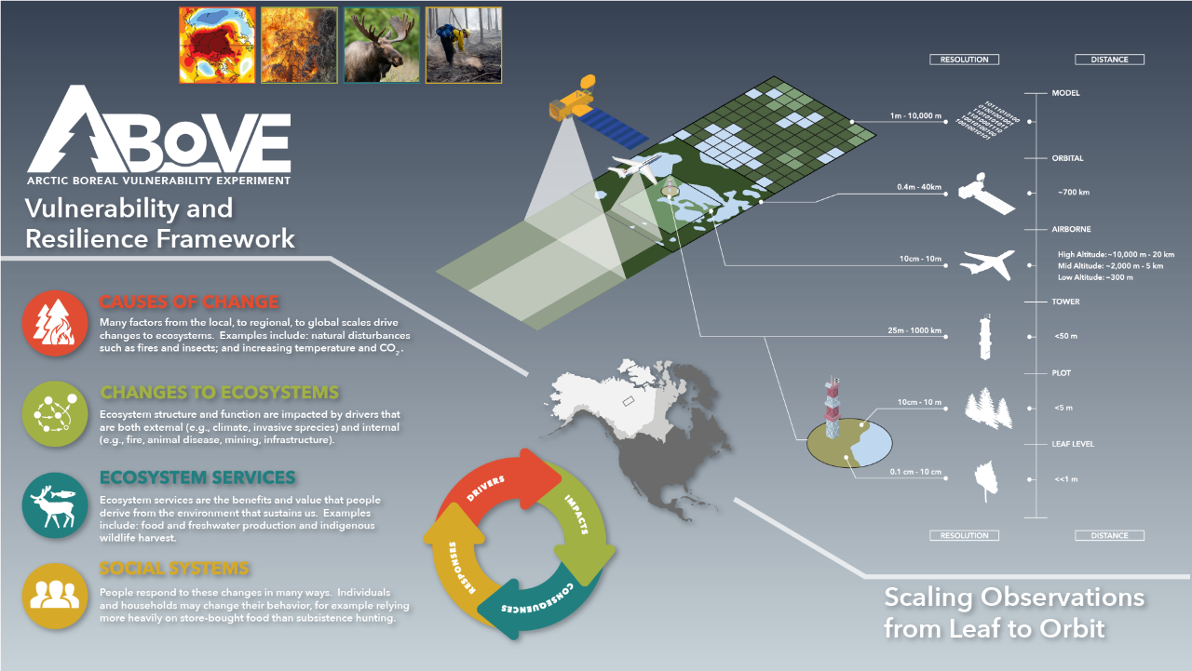

Notes:
ABoVE is a large-scale study of environmental change in the Arctic and boreal regions of western North America and the implications for ecological systems and society. And of course we’re doing this as only NASA can, with a strategy that spans spatial scales from leaf to orbit.
During the course of this 10 year field campaign, we are making observations at plot, tower, airborne, and orbital scales and feeding this data into an integrated modeling framework.
Overarching Science Question:
How vulnerable or resilient are ecosystems and society to environmental change in the Arctic and boreal region of western North America?
Overarching Science Objective:
To investigate the underlying processes and their interactions that control vulnerability and resilience in Arctic and Boreal ecosystems of western North America to environmental change, and to assess how people within and beyond this region may respond to changes in these processes and interactions.
Vulnerability-Resilience Framework

Slide 15
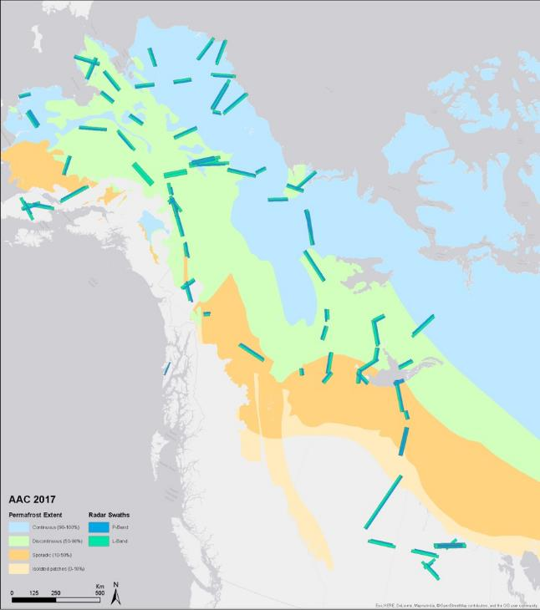
AAC flight lines developed based on careful consideration of all objectives and requirements
SAR flight lines serve as framework & sample important ground truth sites
Cover bioclimatic gradients across ABoVE domain (~4M km2)
Lines & grids modified as needed for for Phase 1 and Phase 2 PI-led projects; Partner priorities
2017: L-band SAR, AVIRIS-NG, LVIS, AirSWOT, CFIS, Arctic-CAP, ASCENDS, P-band SAR, ATOM
2018: L-band SAR, AVIRIS-NG, G-LiHT
2019: L-band SAR, AVIRIS-NG, LVIS, F-SAR (DLR), ASAR (ISRO)
2020: L-band SAR, AVIRIS – Deferred to 2021
2021: L-band SAR; AVIRIS – Deferred to 2022
2022: L-band SAR, AVIRIS-NG, G-LiHT, COMET-2 (DLR)
2023: SnowEx-ABoVE (Apr–May) – AVIRIS-3
2024: L-band SAR
Miller et al. 2019 ERL
PANGEA - NASA Terrestrial Ecology Field Campaign Scoping Study

Slide 16
Accomplishments coming into Phase 3
ABoVE peer-reviewed Publications thus far..
480 reported by 155 projects*
305 by NASA funded projects
(75 TE ABoVE + 48 other projects = 123)
+ 117 by affiliated projects (n=32)*
*As of September 2023, Not including ABoVE Partners (NGEE-Arctic, POLAR, CFS, NEON)
30 pubs in the Nature, Science, PNAS level of journals
Find these publications at above.nasa.gov
The ABoVE science team currently has 967 members
and ~2,000 participants
(incl. resource managers, students & others following)
PANGEA - NASA Terrestrial Ecology Field Campaign Scoping Study

Slide 17
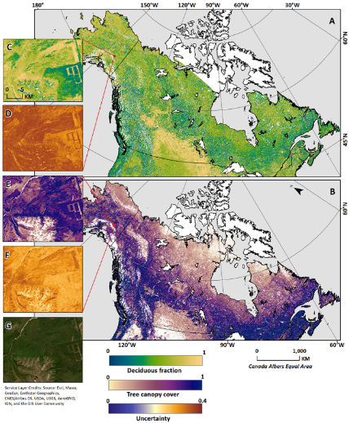
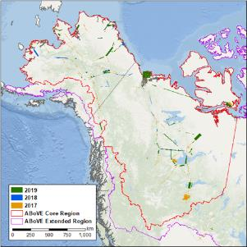
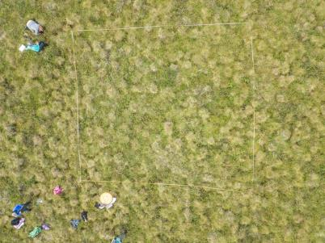
Arctic-Boreal Vulnerability Experiment (ABoVE) Data at the ORNL DAAC
https://daac.ornl.gov/above
Deciduous Fractional Cover and Tree Canopy Cover for Boreal North America, 1992-2015
27 Airborne Science
16 Carbon Dynamics
17 Fire Disturbance
37 Hydrology & Permafrost
3 Project Standards
72 Vegetation
8 Wildlife
180 Total ABoVE datasets
ABoVE flight paths of the AVIRIS-NG instrument during 2017, 2018 and 2019
A 10mx10m Field Site in the Seward Peninsula
PANGEA - NASA Terrestrial Ecology Field Campaign Scoping Study

Slide 18
LBA Large-Scale Biosphere-Atmosphere Experiment in Amazonia
An international program led by Brazil (Brazilian Ministry of Science and Technology)
Initiated in 1998 and still active in Brazil
NASA’s Terrestrial Ecology and Land Use-Land Cover Change Programs participated in LBA through their sponsorship of LBA projects called LBA-ECO
The largest, coordinated, regional Earth system science study
PANGEA - NASA Terrestrial Ecology Field Campaign Scoping Study

Slide 19
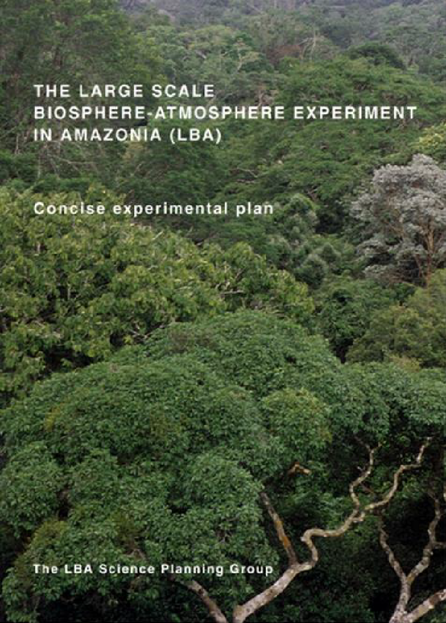
Overarching science questions:
  How does Amazonia function as a regional entity?
  How will changes in land use and climate affect the biological, chemical, and physical functions of Amazonia, including the sustainability of the region and the influence of Amazonia on regional and global climate?
  The LBA-ECO (NASA-TE) Question:
  How do tropical forest conversion, regrowth, and selective logging influence carbon storage, nutrient dynamics, trace gas fluxes, and the prospect for sustainable land use in Amazonia?
PANGEA - NASA Terrestrial Ecology Field Campaign Scoping Study

Slide 20
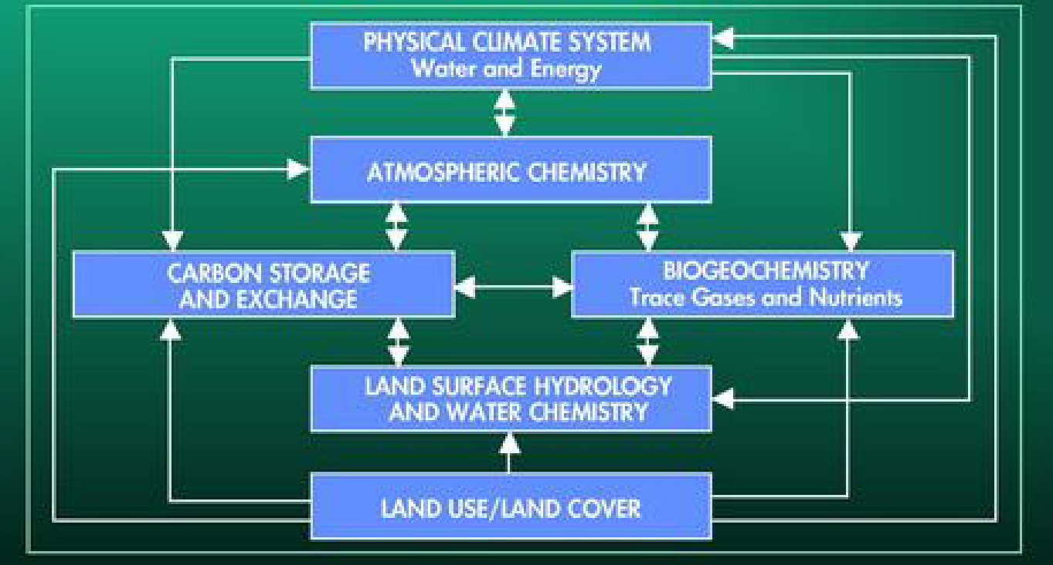
LBA: A multi-disciplinary program
Physical Climate System
Atmospheric Chemistry
Biogeochemistry
Hydrology
Land Use and Land Cover
Human Dimensions
Training and Education
PANGEA - NASA Terrestrial Ecology Field Campaign Scoping Study

Slide 21
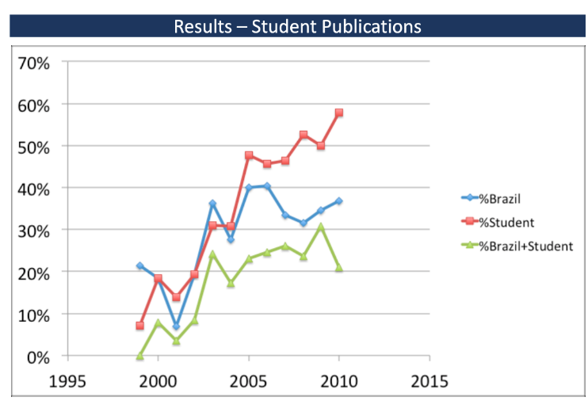
LBA Built Capacity (LBA-ECO Publications)
PANGEA - NASA Terrestrial Ecology Field Campaign Scoping Study

Slide 22
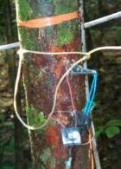
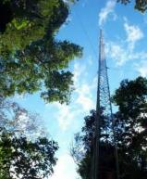
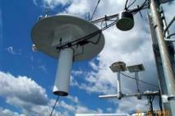
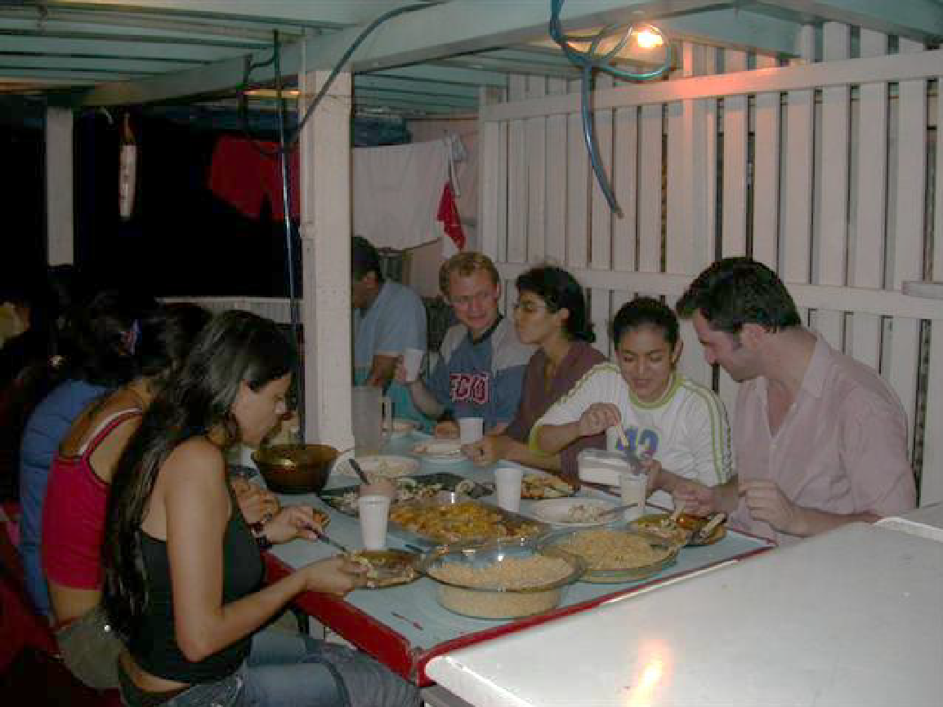
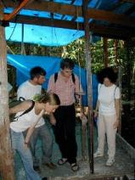
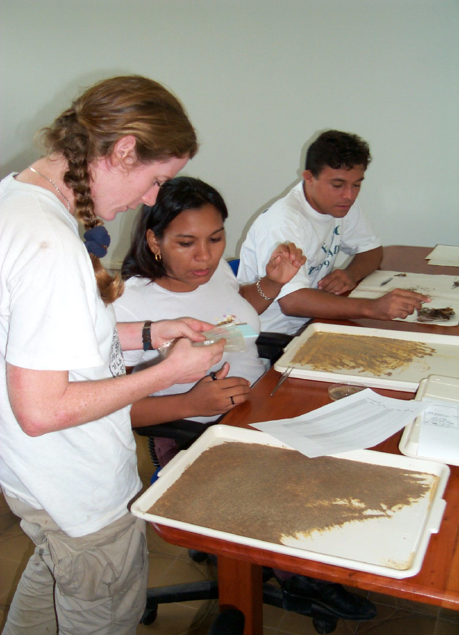
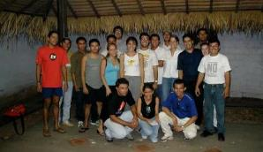
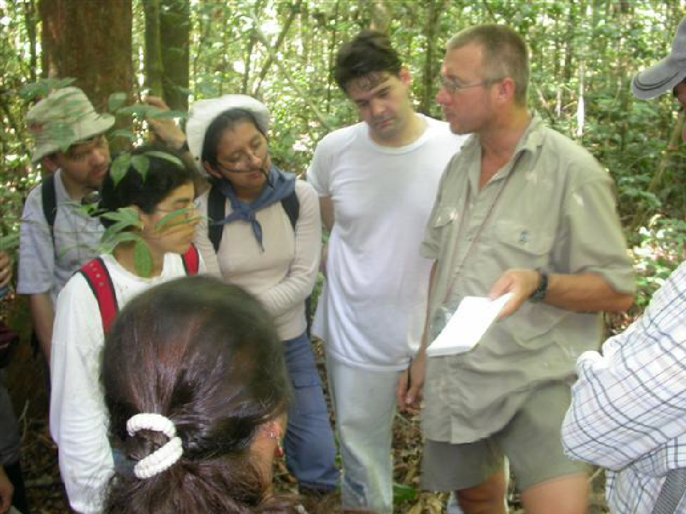
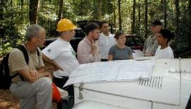
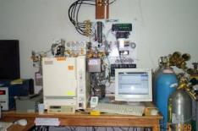
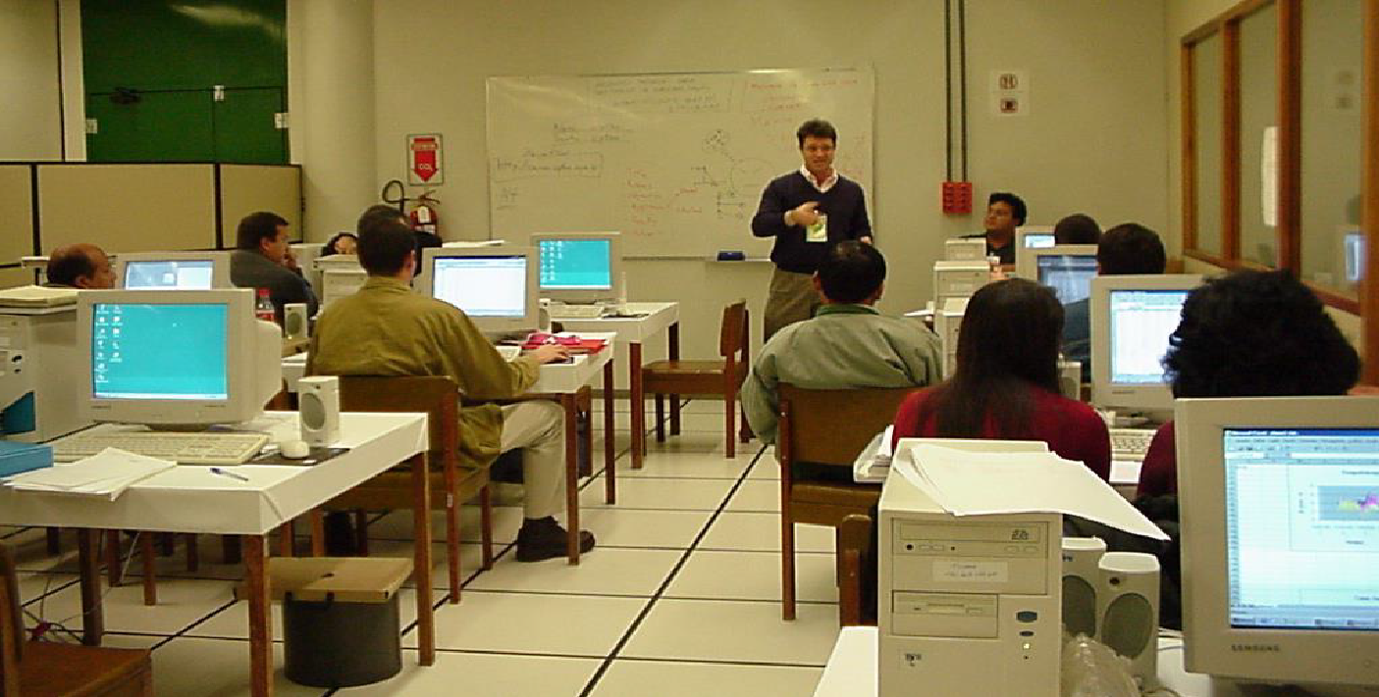
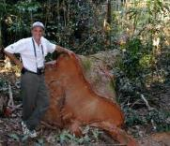
LBA: a monumental effort and a large legacy
>1000 students trained (>500 PhD and MSc)
Nearly 2000 scientists
>2000 scientific papers
PANGEA - NASA Terrestrial Ecology Field Campaign Scoping Study

Slide 23
Why we need to go beyond LBA
LBA started 25 years ago. The world has changed. The climate has changed.
Science and technology have advanced.
We are in a data rich era for satellite observation. By contrast, NASA Terra (ASTER, CERES, MISR, MODIS, MOPPIT) launched in 1999, one year after LBA began.
When we started LBA, we asked how are tropical forests changing. We now ask whether tropical forests will survive the changes.
We need a PAN-tropical campaign 🡪 PANGEA
PANGEA - NASA Terrestrial Ecology Field Campaign Scoping Study
Notes:
Footnote on PANGEA being pantropical – satellite analyses and modeling will be pantropical; during the scoping effort a key objective will be to identify a suite of super sites that will allow from scaling from field to airborne to satellite measurements across the tropics;

Slide 24
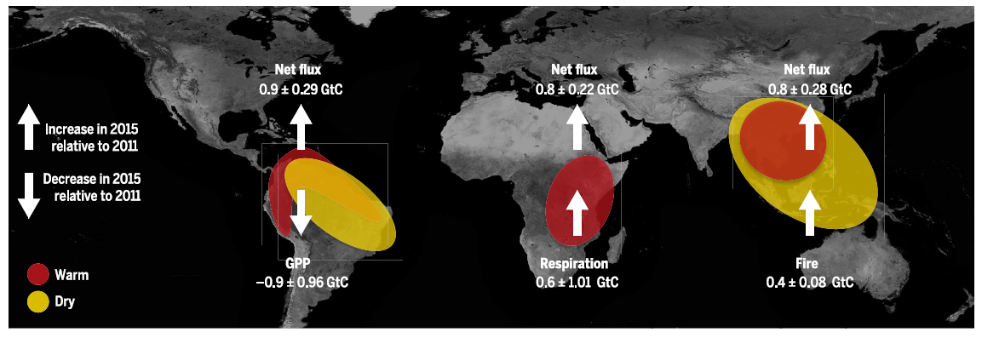
Pan-tropical C source following 2015 El Niño
Distinct regional pathways resulted in net C emissions across tropics
Liu et al. & Eldering et al. 2017 Science
Drier land surface 🡪 Less plant growth 🡪 More CO₂
Higher temperatures 🡪 Increased respiration 🡪 More CO₂
Hotter and drier 🡪 More fire 🡪
More CO₂
PANGEA - NASA Terrestrial Ecology Field Campaign Scoping Study

Slide 25
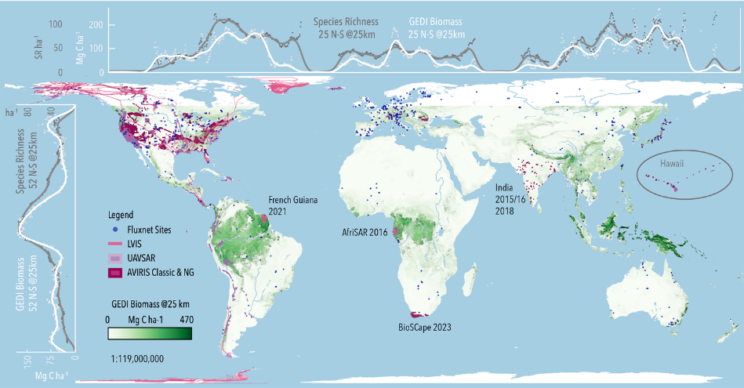
Leveraging existing airborne campaigns
PANGEA - NASA Terrestrial Ecology Field Campaign Scoping Study

Slide 26



Overarching Questions
What are the similarities and differences within and between each tropical regions?
How are the vulnerability and resilience of tropical forest ecosystems changing with global change?
How can this information be used to guide decision making for climate adaptation & mitigation and biodiversity conservation?
PANGEA - NASA Terrestrial Ecology Field Campaign Scoping Study

Slide 27
Science Themes
Biogeochemical cycles & carbon dynamics
Ecosystem structure, function and diversity
Climate feedbacks and interactions
Socio-ecological systems
PANGEA - NASA Terrestrial Ecology Field Campaign Scoping Study

Slide 28
Community Engagement & Next Steps
PANGEA will work with people across disciplines, career stages and continents to:
  Determine scientific priorities across the tropical research community
  Articulate the most pressing and feasible science questions
  Define the geographic scope and identify field sites
  Create a research environment that supports historically marginalized voices, researchers and communities
  Guide societal responses to land cover change and climate change
PANGEA - NASA Terrestrial Ecology Field Campaign Scoping Study

Slide 29




























Funding Support
Institutional Partners
PANGEA - NASA Terrestrial Ecology Field Campaign Scoping Study

Slide 30
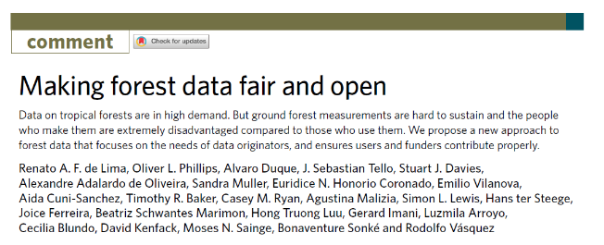
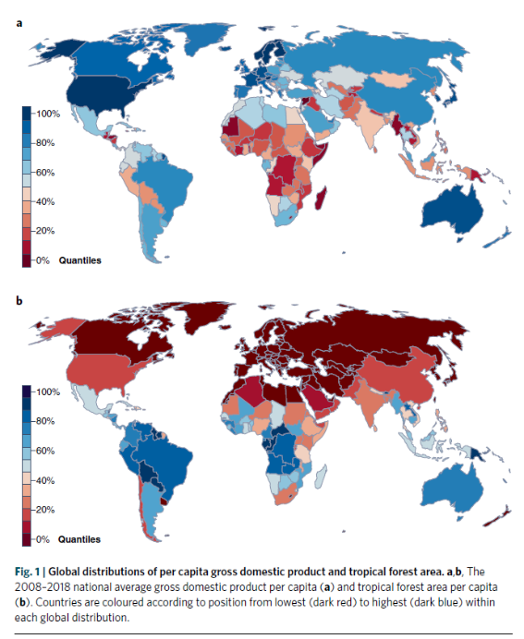
Key Problems
“Open data” does not mean open for all, and can widen or entrench structural inequalities
Many countries that hold substantial areas of tropical forests are least able to invest in science and development
de Lima et al. 2022 Nature Ecology & Evolution

Slide 31
Recommendations
Fund direct and indirect costs, overhead of institutions responsible for data delivery, and data curation and data infrastructure needs
Embrace holistic definition of authorship
Ensure results communicated in originators’ languages
Develop international agreements to support capacity building & stable, long-term careers for data providers
Develop deep, long-term, equitable collaborations
de Lima et al. 2022 Nature Ecology & Evolution

Slide 32

Get Involved
Join a Working Group
  Biogeochemical cycles & carbon dynamics
  Ecosystem structure, function, and biodiversity
  Climate feedbacks and interactions
  Socio-ecological systems
  Feasibility
  Community Engagement
  Research and Applications Output
Attend a workshop
Help us spread the word
Be on the lookout for a request for information (RFI)
Check our Activities Page for updates and new information
PANGEA - NASA Terrestrial Ecology Field Campaign Scoping Study

Slide 33
Questions?
Briefly introduce yourself
What do you want this campaign to accomplish?
Questions for the leadership team?
Drop ideas and suggestions in the Google Jamboard
PANGEA - NASA Terrestrial Ecology Field Campaign Scoping Study

Slide 34

PANGEA Scoping Timeline
AGU Town Hall
c
Asia Regional Consultation
Writing workshop
Kick-off webinar
Africa Regional Consultation
Community workshop
Americas Regional Consultation
Webinar + Feedback
White paper to NASA
Working groups
Community engagement
Nov 2023
Jan 2024
Mar 2024
May 2024
July 2024
Sept 2024
Nov 2024
Jan 2025
PANGEA - NASA Terrestrial Ecology Field Campaign Scoping Study

