Slide 1
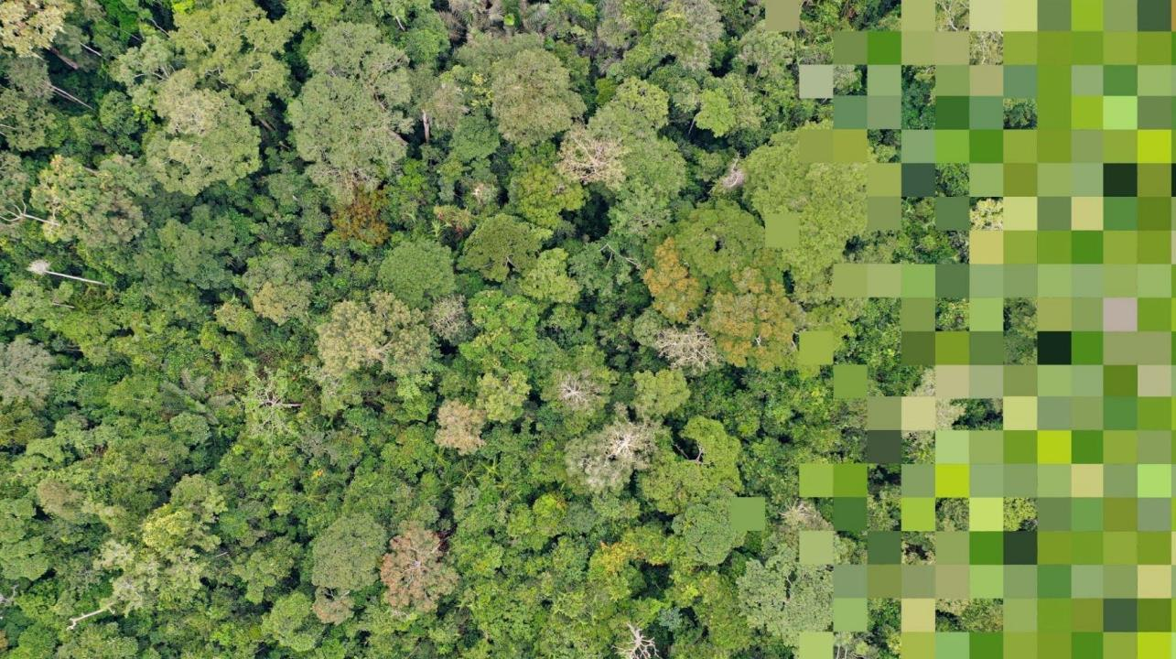



PANGEA
PAN tropical investigation of bioGeochemistry and Ecological Adaptation
Day 3 - Session 13: Community Engagement &
Involvement in PANGEA
Workshop on impacts of unusual weather events and climate anomalies on Amazon rainforest
May 20-22, 2024

Slide 2

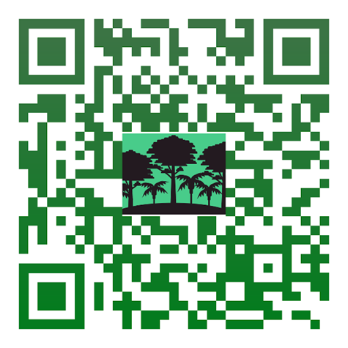


Agenda
PANGEA Community Engagement Updates
Working Definitions: Community, End-Users
NASA Capacity Building Opportunities
Community Engagement Opportunities in Amazonia
PANGEA - NASA Terrestrial Ecology Field Campaign Scoping Study Workshop

Slide 3
Community engagement activities
Workshops
Africa Workshop in Cameroon (February)
Cameroon Women in Science virtual session (April)
Americas – Brazil & Peru (May & June)
Thailand – joining NASA SERVIR (May)
Virtual Community engagement workshops
  Panama Indigenous community (April)
Partner engagement
Over 60 meetings with partners and partner institutions
Conference Town Halls & Sessions
AGU Town Hall (December 2023)
ESA webinar (March)
EGU Town Hall (April)
CBFP Meeting (June)
ATBC Special Session (August)
Global Land Project Special Session (November)
NASA Program & Mission engagement
Land-Cover and Land-Use Change meeting (April)
Biological Diversity & Ecological Conservation ST meeting (May)
SMAP meeting (May)
Surface Biology Geology SATI meeting (May)
PANGEA - NASA Terrestrial Ecology Field Campaign Scoping Study Workshop
Notes:
PANGEA Cameroon Women's Session - incredibly grateful to Adia Bey for organizing and leading this

Slide 4
How do we define ‘community’?
Science community
Policy community
Practitioner community
Indigenous and Traditional communities
PANGEA - NASA Terrestrial Ecology Field Campaign Scoping Study Workshop

Slide 5
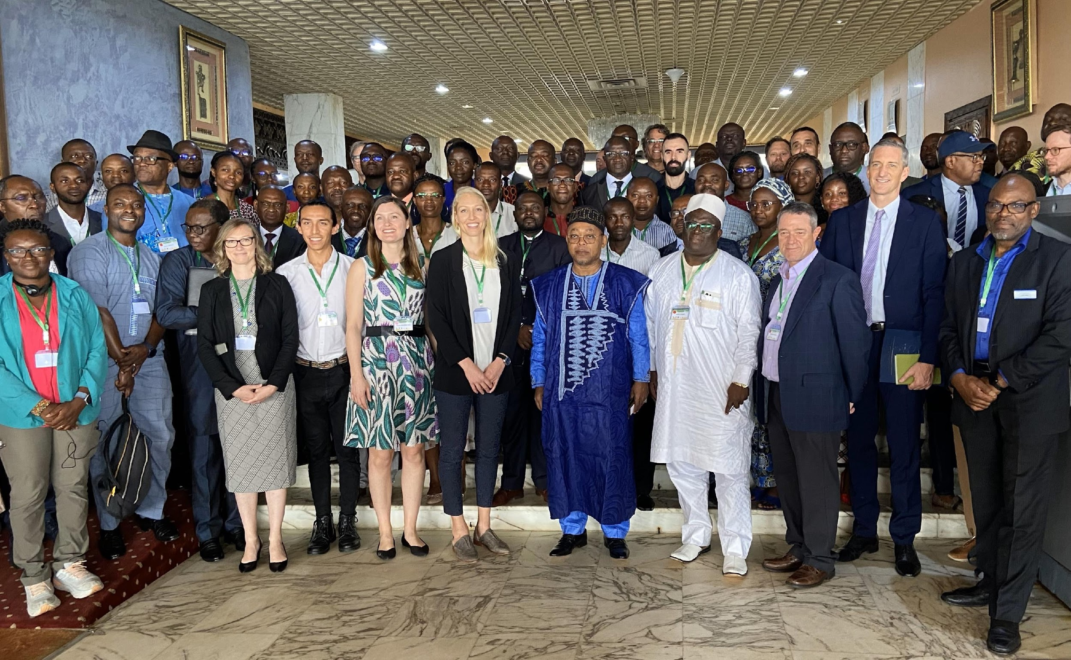

An energizing workshop with the African research community
Build capacity - train the next generation of scientists from African countries. Requires going beyond data collection.
Encourage regional collaboration and pan-tropical research exchange
Advance monitoring capabilities (weather risk predictions, agricultural, carbon, biodiversity)
Reinforce existing activities and centers of excellence
Engage local communities and facilitate the transfer of research advances to improving local livelihoods
Include government, students, national and regional research institutions, NGOs, communities, policy-makers, and the private sector
PANGEA - NASA Terrestrial Ecology Field Campaign Scoping Study Workshop
Notes:
PANGEA Cameroon Women's Session - incredibly grateful to Adia Bey for organizing and leading this

Slide 6
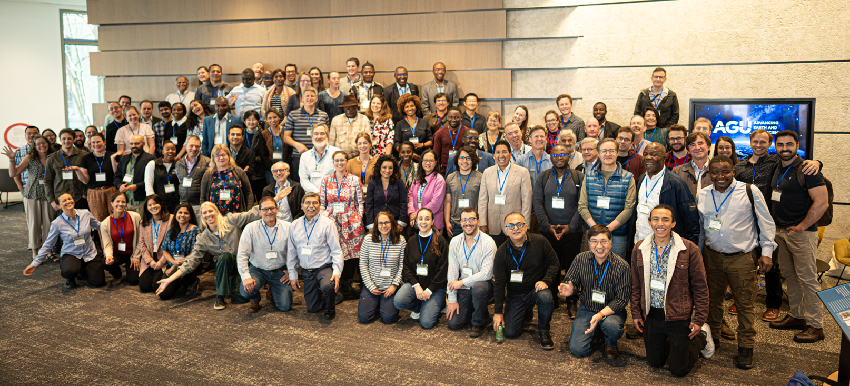
Well-attended Washington DC in April
PANGEA - NASA Terrestrial Ecology Field Campaign Scoping Study Workshop

Slide 7
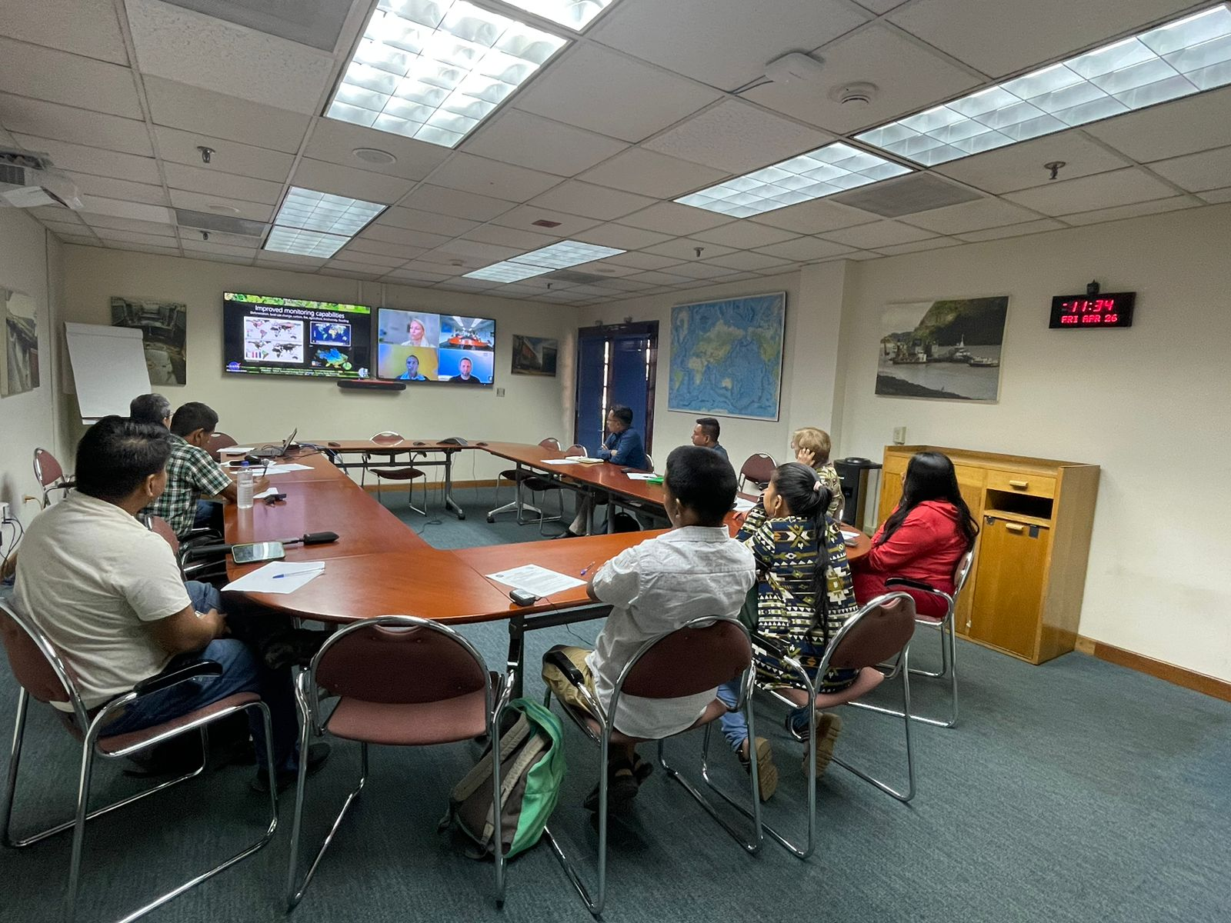
Important Takeaways from Indigenous representatives at the Panama Hybrid Workshop
Traditional and Ecological Knowledge is threatened
Consultation with Indigenous territories needed in earliest phase
Active partners in research for development and natural hazard mitigation
White Paper opportunity to co-develop research authorization practices
PANGEA - NASA Terrestrial Ecology Field Campaign Scoping Study Workshop
Notes:
Important topics that emerged:
The workshop highlighted key themes like the profound knowledge Indigenous communities hold about their territories and the urgency of protecting those areas. Emphasizing Indigenous collaboration as essential, it addressed concerns ranging from water and biodiversity to fire management. The discussion advocated for a shift in viewing Indigenous peoples not as passive recipients but as active partners in research and development efforts. It also explored strategies for respectful research, integrating Indigenous perspectives, and providing training in technologies like drones. Importantly, the workshop stressed the necessity of including traditional knowledge in data integration and recognizing Indigenous expertise for effective scientific monitoring and conservation efforts.

Slide 8
What are the best practices for community engagement in tropical forest research?
Social-historical perspectives motivate the need for ethical and true collaboration
Key Idea: Long-Term Relationships for Community-Centered Science
Best practices to develop with communities
  Data Products, Transparency, and Sovereignty
  Translational, Language, and Knowledge System Justice
  Economic Justice
PANGEA - NASA Terrestrial Ecology Field Campaign Scoping Study Workshop
Notes:
We need to acknowledge historical biases and adopt transformative practices for equitable collaboration. This means prioritizing long-term relationships with local communities, centering their needs in our research goals, and ensuring culturally responsive engagement. Our best practices include co-developing research questions, transparent collaboration guidelines, respecting data sovereignty, and supporting economic justice. Let's shift towards community-centered science to build meaningful collaborations and rectify historical harms in tropical research. Please come up to me if these topics interest you!

Slide 9
How do we define ‘end-users’?
A person, institution, or organization who uses an end-product.
A user is an individual or organization that uses the data, information, or other products to support their activities for their benefit or for the benefit of others.
PANGEA - NASA Terrestrial Ecology Field Campaign Scoping Study Workshop
Notes:
VZ note: I would introduce the idea of bi-directional flow of information here

Slide 10
End user communities include:
Government
Natural resource managers
Civil-society organizations
Non-profits
Private-sector companies
Those involved in ecosystem management, climate mitigation and adaptation, and sustainable agriculture
PANGEA - NASA Terrestrial Ecology Field Campaign Scoping Study Workshop

Slide 11
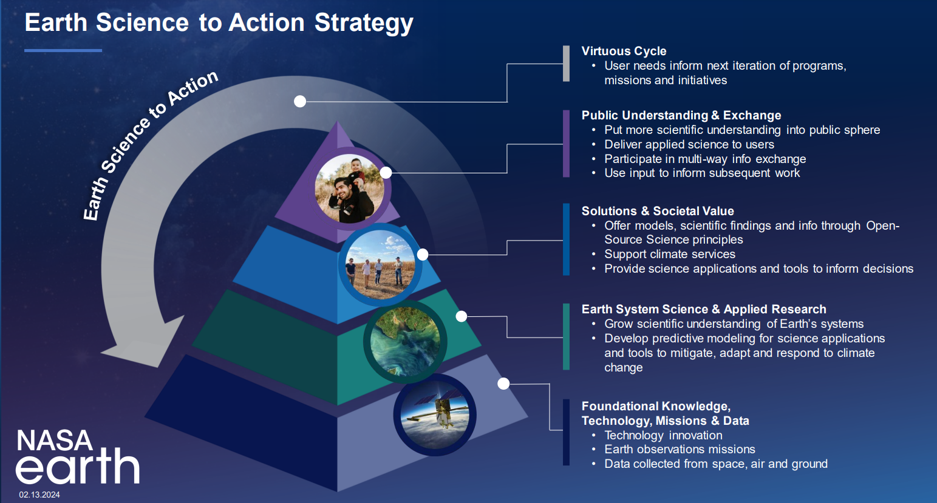
NASA Earth Science to Action (ES2A) Strategy
PANGEA - NASA Terrestrial Ecology Field Campaign Scoping Study Workshop
Notes:
Emphasis on applications! - New Earth Science 2 Action strategy
NASA wants to encourage people to cross the layers of the pyramid

Slide 12
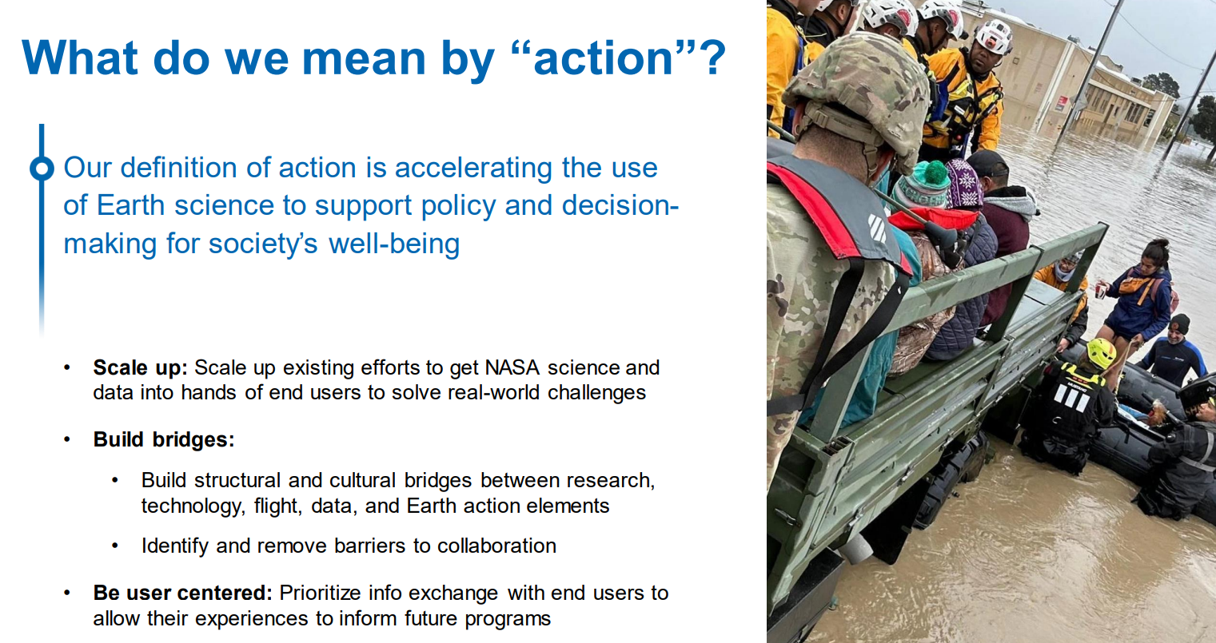
NASA Earth Science to Action (ES2A) Strategy
PANGEA - NASA Terrestrial Ecology Field Campaign Scoping Study Workshop

Slide 13
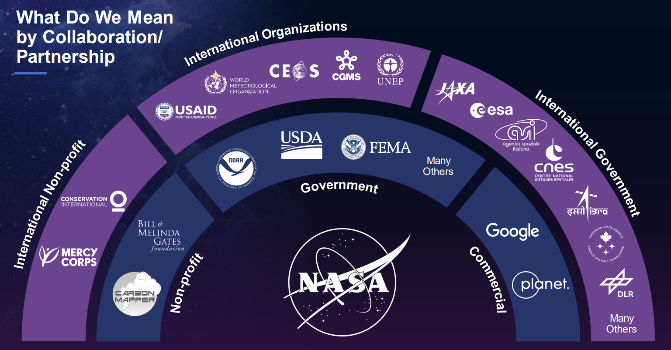
NASA Earth Science to Action (ES2A) Strategy
PANGEA - NASA Terrestrial Ecology Field Campaign Scoping Study Workshop

Slide 14


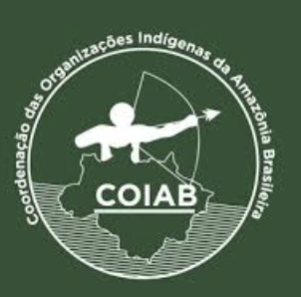
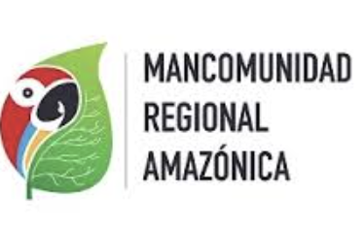


Users/Stakeholders/Communities in Amazonia
Networks of stakeholders & communities in Amazonia
Place-based
Indigenous Peoples and other traditional communities
Quilombolas, rubber tappers; Riberinhos.
Indigenous and rural Women's organizations
Local producers
Agricultural / agroforestry manufacturers/ artisans
Subnational governments
Amazonas, Pará, San Martin, Loreto
Amazonian Cities
Manaus, Iquitos, Belen
Scientific & Higher education communities
Schools networks
Non-place-based
Networks of community & right-holders organizations
COIAB,
COICA,
Scientific communities
Conservation and climate professionals
Human rights organizations
Networks of Founders, & philanthropists committed to the Amazon
Larger-scale Industrial investors
PANGEA - NASA Terrestrial Ecology Field Campaign Scoping Study Workshop
Notes:
Por un lado esta trabajar con las organizaciones ind’igenas a nivel local para generar capacidades *ej. Estudiantes de universidades aliadas, trabajo en MA y PHD

Slide 15
Questions for Community Engagement
How to engage with communities early on in research campaign development?
How to recognize sovereignty and agency of sensitive data in academic research?
How to budget funding for academic student assistantships and technicians in research proposals?
What are partners and networks in Amazonia to connect with?
How to scale from local Amazonia to pan-tropics?
Isaac Aguilar – inaguilar@ucla.edu
PANGEA - NASA Terrestrial Ecology Field Campaign Scoping Study Workshop

