Slide 1
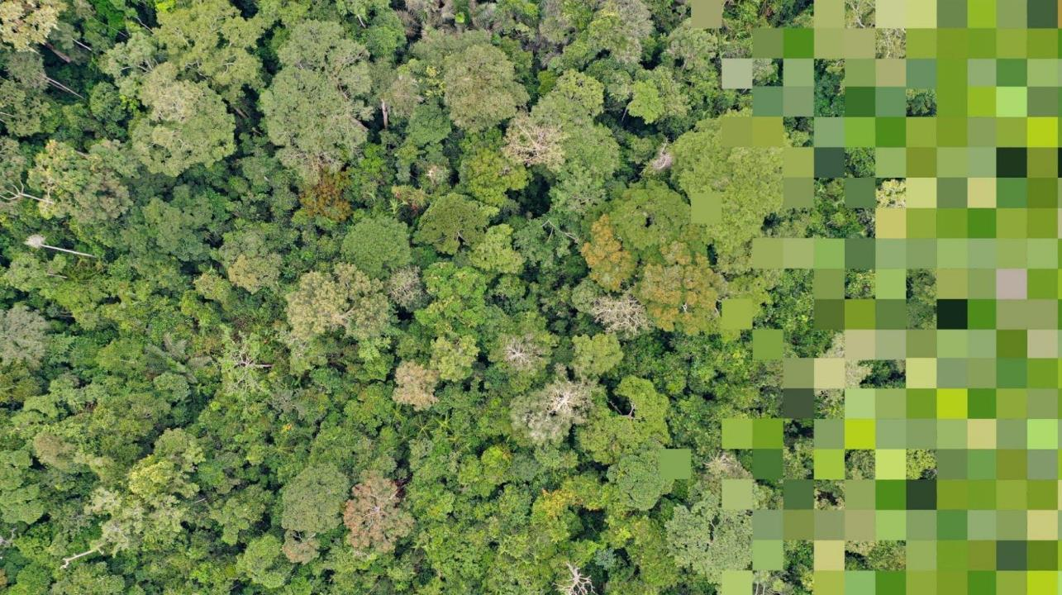


PANGEA
PAN tropical investigation of bioGeochemistry and Ecological Adaptation
A scoping study for a NASA Tropical Forest
Terrestrial Ecology Campaign
Un estudio preliminar para una campaña de ecología
terrestre en la selva tropical de la NASA
Elsa Ordway, PANGEA PI
BCI 100 – June 20, 2024

Slide 2


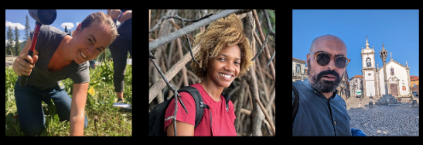
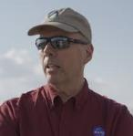
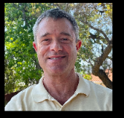
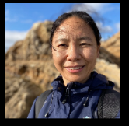

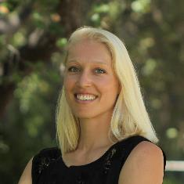

PANGEA Leadership Team | Equipo de liderazgo
Isaac Aguilar
UCLA
Adia Bey
NASA Goddard
Dana Chadwick JPL
Lola Fatoyinbo
NASA Goddard
António Ferraz
UCLA / JPL
Peter Griffith
NASA Goddard
Michael Keller
USFS
Junjie Liu
JPL
Chip Miller
JPL
Elsa Ordway (PI)
UCLA
Fabian Schneider
JPL
Bonaventure Sonké
Univ. of Yaoundé I
Hannah Stouter
UCLA
Xiangming Xiao
Univ. of Oklahoma
PANGEA - NASA Terrestrial Ecology Field Campaign Scoping Study
Notes:
PANGEA is very much a team effort. We have an incredible leadership team that brings a great deal of expertise from NASA campaigns past and present who very much want this to result in a campaign proposal that reflects community needs and desires.

Slide 3
Las campañas de campo de ecología terrestre
de la NASA están destinadas a:
Answer big science questions targeted on important regions or biomes;
Enable more effective interpretation and analysis of space-based measurements;
Foster collaborative interactions and building new relationships within the scientific community;
Provide valuable opportunities for training and educating the next generation of scientists; and
Leave a legacy data set of great value for future research
Responder grandes preguntas científicas enfocadas en regiones o biomas importantes;
Permitir una interpretación y análisis más efectivos de mediciones basadas en el espacio;
Fomentar interacciones colaborativas y construir nuevas relaciones dentro de la comunidad científica;
Proveer oportunidades valiosas para la formación y educación de la próxima generación de científicos; y
Dejar un conjunto de datos legado de gran valor para la investigación futura.
PANGEA - NASA Terrestrial Ecology Field Campaign Scoping Study
Notes:
NASA terrestrial ecology field campaigns are meant to … (read from the slide)

Slide 4
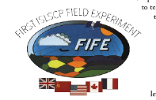
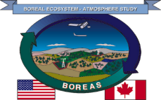
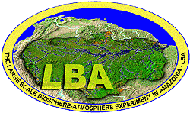

Campañas de campo anteriores de la NASA
FIFE: First International Satellite Land Surface Climatology Project (ISLSCP) Field Experiment (1987-1989)
BOREAS: Boreal Ecosystem-Atmosphere Study (1992-1999)
LBA: Large-scale Biosphere-Atmosphere Experiment in Amazonia (1998-2011)
ABoVE: Arctic Boreal Vulnerability Experiment (2015-2024)
PANGEA - NASA Terrestrial Ecology Field Campaign Scoping Study
Notes:
NASA has a long history of successful TE field campaigns, going back to the late 1980s. The current campaign, ABoVE is focused on arctic and boreal system responses to climate change, with data collection efforts in western Canada and the US. Prior to ABoVE was the LBA, led by Brazil in the late 1990s and early 2000s. LBA advanced understanding of the Amazon as a holistic entity, and was also transformative in its capacity building efforts. It trained over 1000 PhD and Master’s students, many of whom were from Brazil and have since gone on to be leaders in their field.

Slide 5
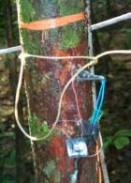
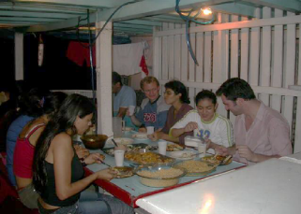
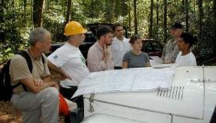
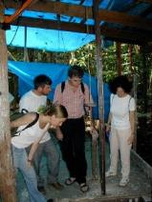
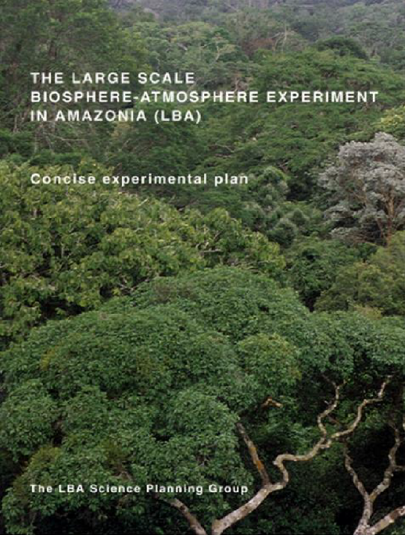
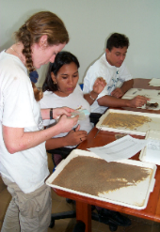
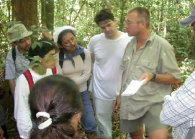
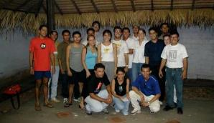
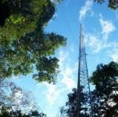
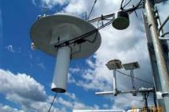
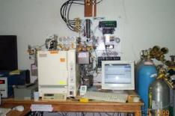
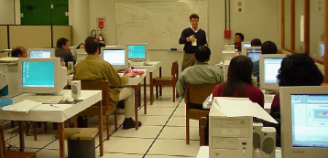
LBA abrió el camino
PANGEA - NASA Terrestrial Ecology Field Campaign Scoping Study

Slide 6
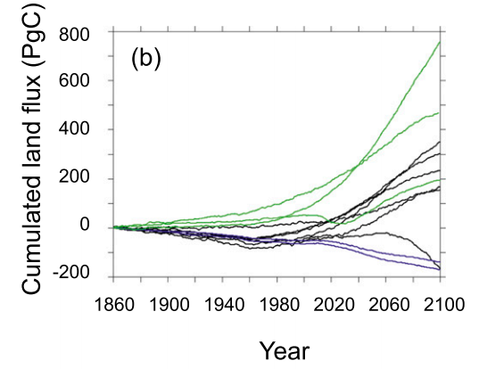
Alta incertidumbre en el flujo de carbono terrestre futuro
Terrestrial systems store ~750 PgC by 2100
[-] = C emissions to the atmosphere
[+] = C uptake from the atmosphere
Terrestrial systems emit ~170 PgC by 2100
Friedlingstein et al 2014 AMS
Earth System Models accounting for terrestrial N cycle
Earth System Models prescribing land use change emissions
PANGEA - NASA Terrestrial Ecology Field Campaign Scoping Study
Notes:
There remains enormous uncertainty in the future of the terrestrial land carbon flux. Earth system models predicting the land carbon flux at the end of the century (11 of which are shown here) don’t even agree on the sign.
Some models suggest that the land carbon flux will continue to store more carbon on net, while other models suggest that the land carbon flux could become an additional source of net C emissions.

Slide 7
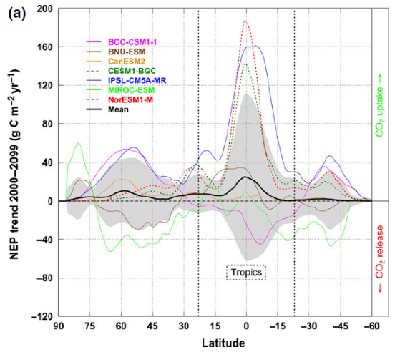
Los trópicos dominan la incertidumbre
Terrestrial systems store ~750 PgC by 2100
[-] = C emissions to the atmosphere
[+] = C uptake from the atmosphere
Tropics
Terrestrial systems emit ~170 PgC by 2100
Cavaleri et al. 2015 Global Change Biology
Friedlingstein et al 2014 AMS
Earth System Models accounting for terrestrial N cycle
Earth System Models prescribing land use change emissions
PANGEA - NASA Terrestrial Ecology Field Campaign Scoping Study
Notes:
Studies have also shown that most of this uncertainty in due to model variability within the tropics. You’re seeing here a figure with latitude on the x-axis and Net Ecosystem Productivity trends from 2000 to the end of the century across different Earth System Models. Variability is 3 times greater in the tropics than at other latitudes.

Slide 8
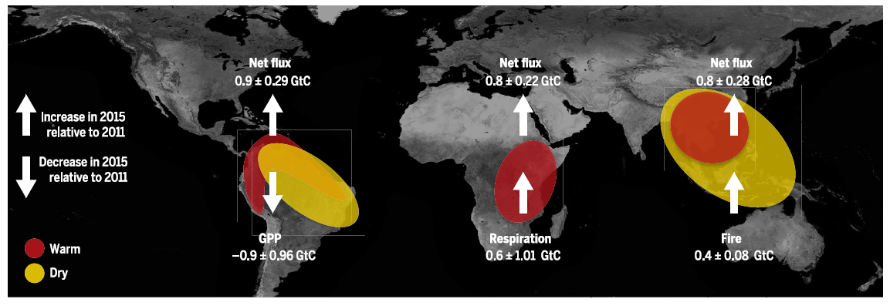
Fuente de carbono pan-tropical tras el Niño de 2015
Diversas trayectorias regionales resultaron en emisiones netas de carbono en los trópicos
Liu et al. & Eldering et al. 2017 Science
Superficie terrestre más seca →
Menor crecimiento de plantas → Más CO₂
Temperaturas más altas → Aumento de la respiración → Más CO₂
Más caliente y más seco → Más fuego →
Más CO₂
PANGEA - NASA Terrestrial Ecology Field Campaign Scoping Study
Notes:
We are already seeing that the tropical land flux is becoming increasingly fragile in response to extreme events. You’re seeing here results form an analysis of Orbiting Carbon Observatory (OCO-2) data that was led by Junjie Liu at JPL. Junjie and her co-authors found that although on average, the tropics are a net carbon sink, they all flipped to become sources of CO2 emissions during the 2015 El Nino, but for different reasons.
In the Americas, a direr land surface led to reduced plant growth. In Africa, higher temperatures led to increased respiration, and in Southeast Asia, hotter and drier conditions led to more fires, all of which resulted in more CO2 emissions from each region.

Slide 9
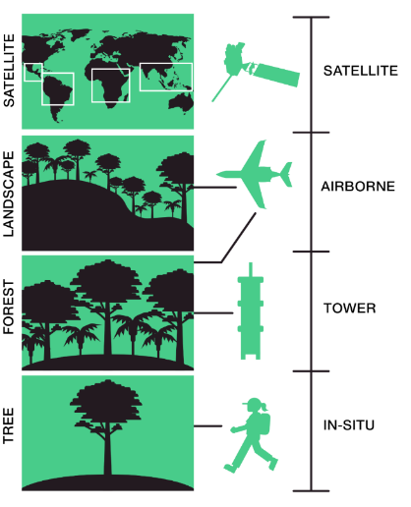
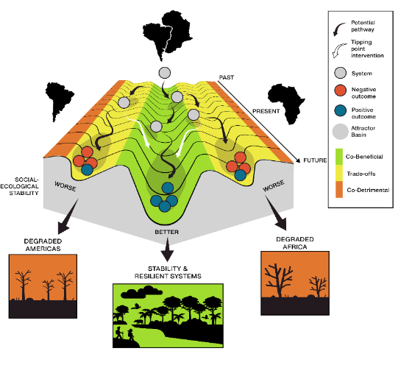

¿Qué es PANGEA?
PANGEA Sitio web
tinyurl.com/tropicalscoping
REGION
SPACEBORNE
LANDSCAPE
AIRBORNE
FOREST
TOWER
TREE
IN SITU
PANGEA - NASA Terrestrial Ecology Field Campaign Scoping Study
Notes:
So what is PANGEA
PANGEA is a scoping study selected by NASA’s Terrestrial Ecology Program to
work with tropical scientists and partners as well as the remote sensing community to outline a future NASA field campaign focused on the tropics
to understand how climate change and land use are impacting the vulnerability and resilience of tropical forests across time and space.
Integrating data and knowledge from local to regional to pantropical scale
PANGEA was selected as one of two possible options for NASA’s next decadal Terrestrial Ecology Campaign.
This workshop is one of many activities to bring together the research community to define the goals and priorities of a possible decadal campaign in the tropics.

Slide 10
How do climate change and land-use change interact with the heterogeneous structure, function, and biodiversity of tropical forest biomes to affect the current and future carbon balance of the tropics?
¿Cómo interactúan el cambio climático y el cambio en el uso del suelo con la estructura, la función y la biodiversidad heterogénea de los biomas de bosques tropicales para afectar el balance de carbono actual y futuro de los trópicos?
PANGEA - NASA Terrestrial Ecology Field Campaign Scoping Study

Slide 11
Enfoque científico de PANGEA
How does ongoing and projected changing climate impact the resilience of the tropical carbon sink and how does the weakening of the carbon sink feedback on the climate?
How does variation in ecosystem structure, ecosystem function, biodiversity, and land-use change within and among regions in the tropics contribute to differences in the resilience of the carbon sink?
How do current and future responses of the tropical carbon sink to shifting trends and extreme events influence climate feedbacks and biogeochemical cycles, and how do these feedbacks influence people?
¿Cómo afecta el cambio climático en curso y proyectado la resiliencia del sumidero de carbono tropical y cómo la debilitación del sumidero de carbono retroalimenta el clima?
¿Cómo contribuye la variación en la estructura del ecosistema, la función del ecosistema, la biodiversidad y el cambio en el uso del suelo dentro y entre regiones en los trópicos a las diferencias en la resiliencia del sumidero de carbono?
¿Cómo influyen las respuestas actuales y futuras del sumidero de carbono tropical a las tendencias cambiantes y eventos extremos en las retroalimentaciones climáticas y los ciclos biogeoquímicos, y cómo estas retroalimentaciones afectan a las personas?
PANGEA - NASA Terrestrial Ecology Field Campaign Scoping Study
Notes:
A coordinated campaign like PANGEA will leverage and advance our ability to use these types of data to address 3 overarching questions

Slide 12
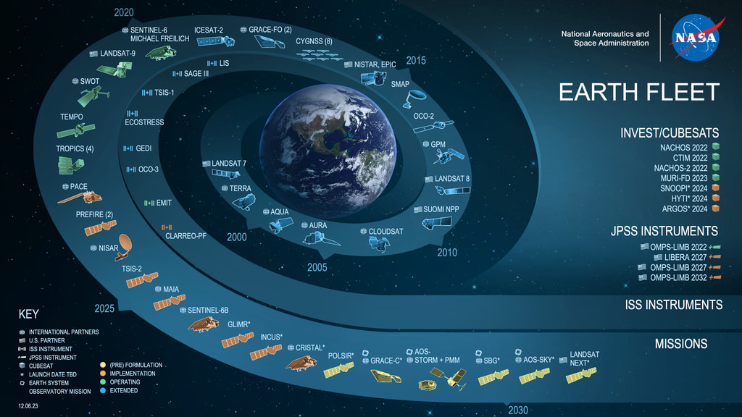
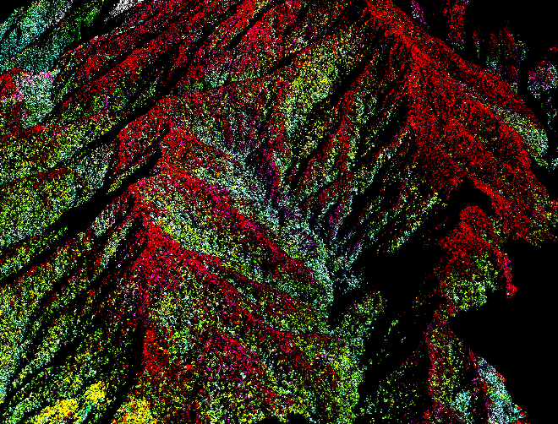
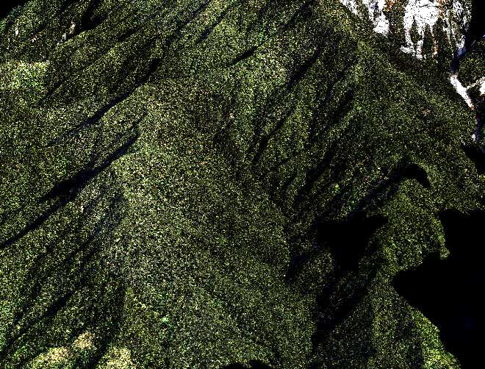
Era rica en datos de observaciones de la Tierra por satélite
Image credit: K. Dana Chadwick
PANGEA - NASA Terrestrial Ecology Field Campaign Scoping Study
Notes:
As we urgently work to understand these changes and their drivers, there is a huge opportunity to leverage data rich moment
After decades of understanding these systems based largely on variation in greenness, we can now observe the planet in greater dimensionality, using current and forthcoming spaceborne lidar, radar, and hyperspectral datasets.
Critically, though, accurate interpretation and use of these data requires coordinated ground data collection, at least in the early development of algorithms.

Slide 13
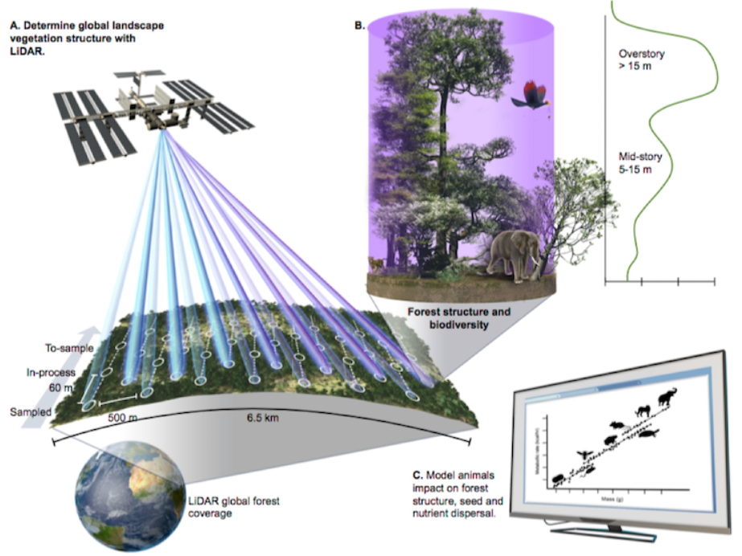
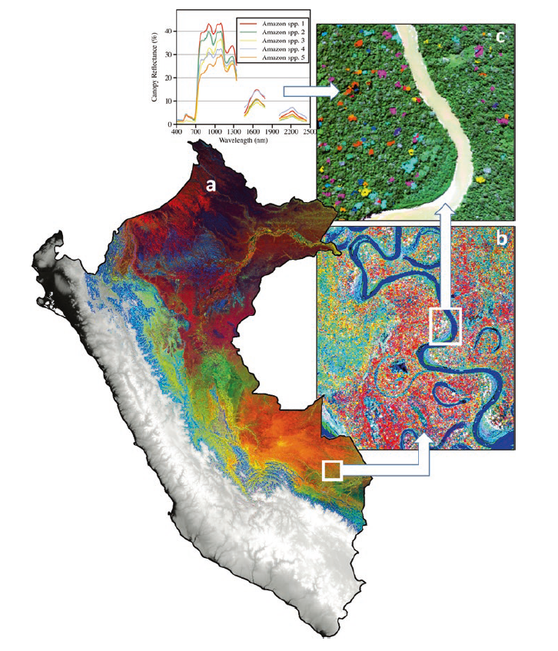
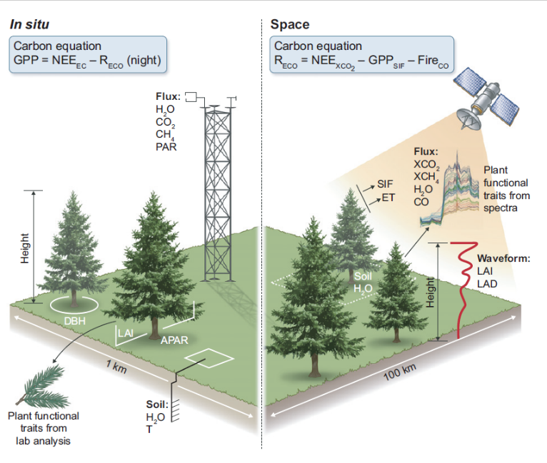
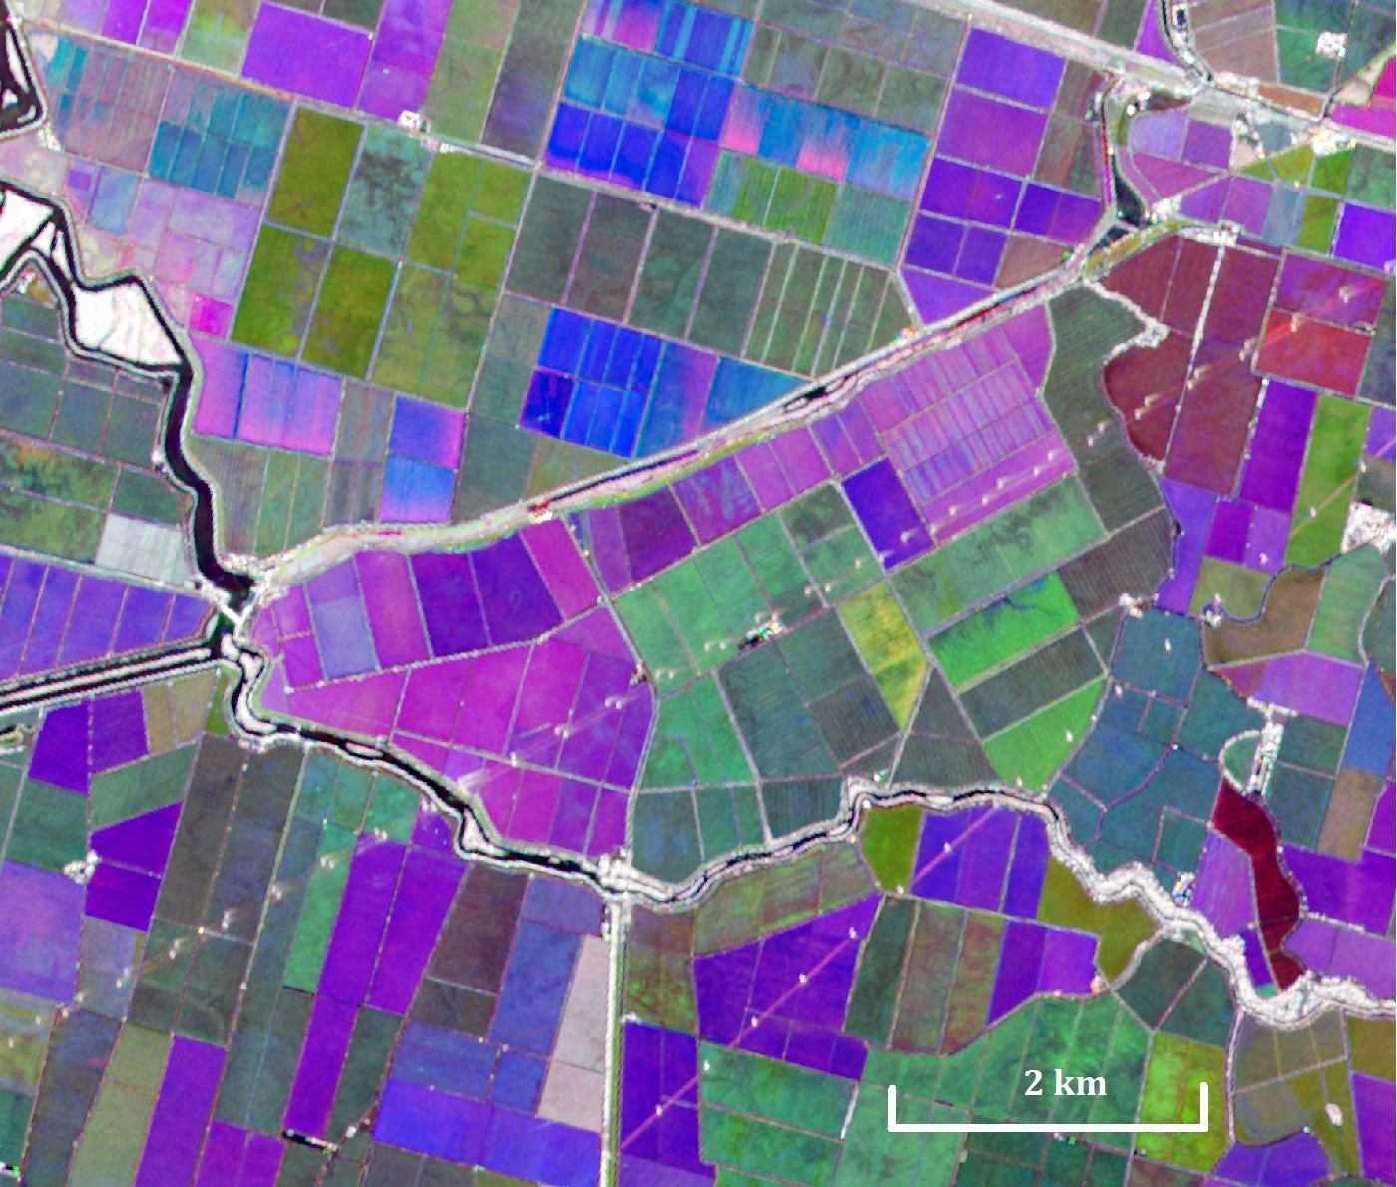
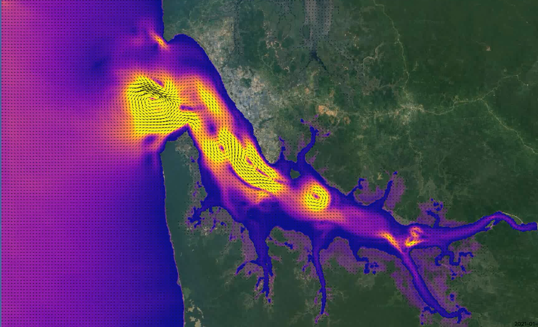
Nuevos sensores aéreos y espaciales
Global Ecosystem Dynamics Investigation (GEDI)
Schimel et al 2015 New Phytologist
NISAR
SWOT
Martin 2020 Remote Sensing of Plant Biodiversity
PANGEA - NASA Terrestrial Ecology Field Campaign Scoping Study
Notes:
Examples of the use of these data include lidar data that enable mapping of canopy height and carbon stocks, as well as hyperspectral data that allow us to map functionally important plant traits that correspond to important differences in plant growth strategies and responses to disturbance.

Slide 14
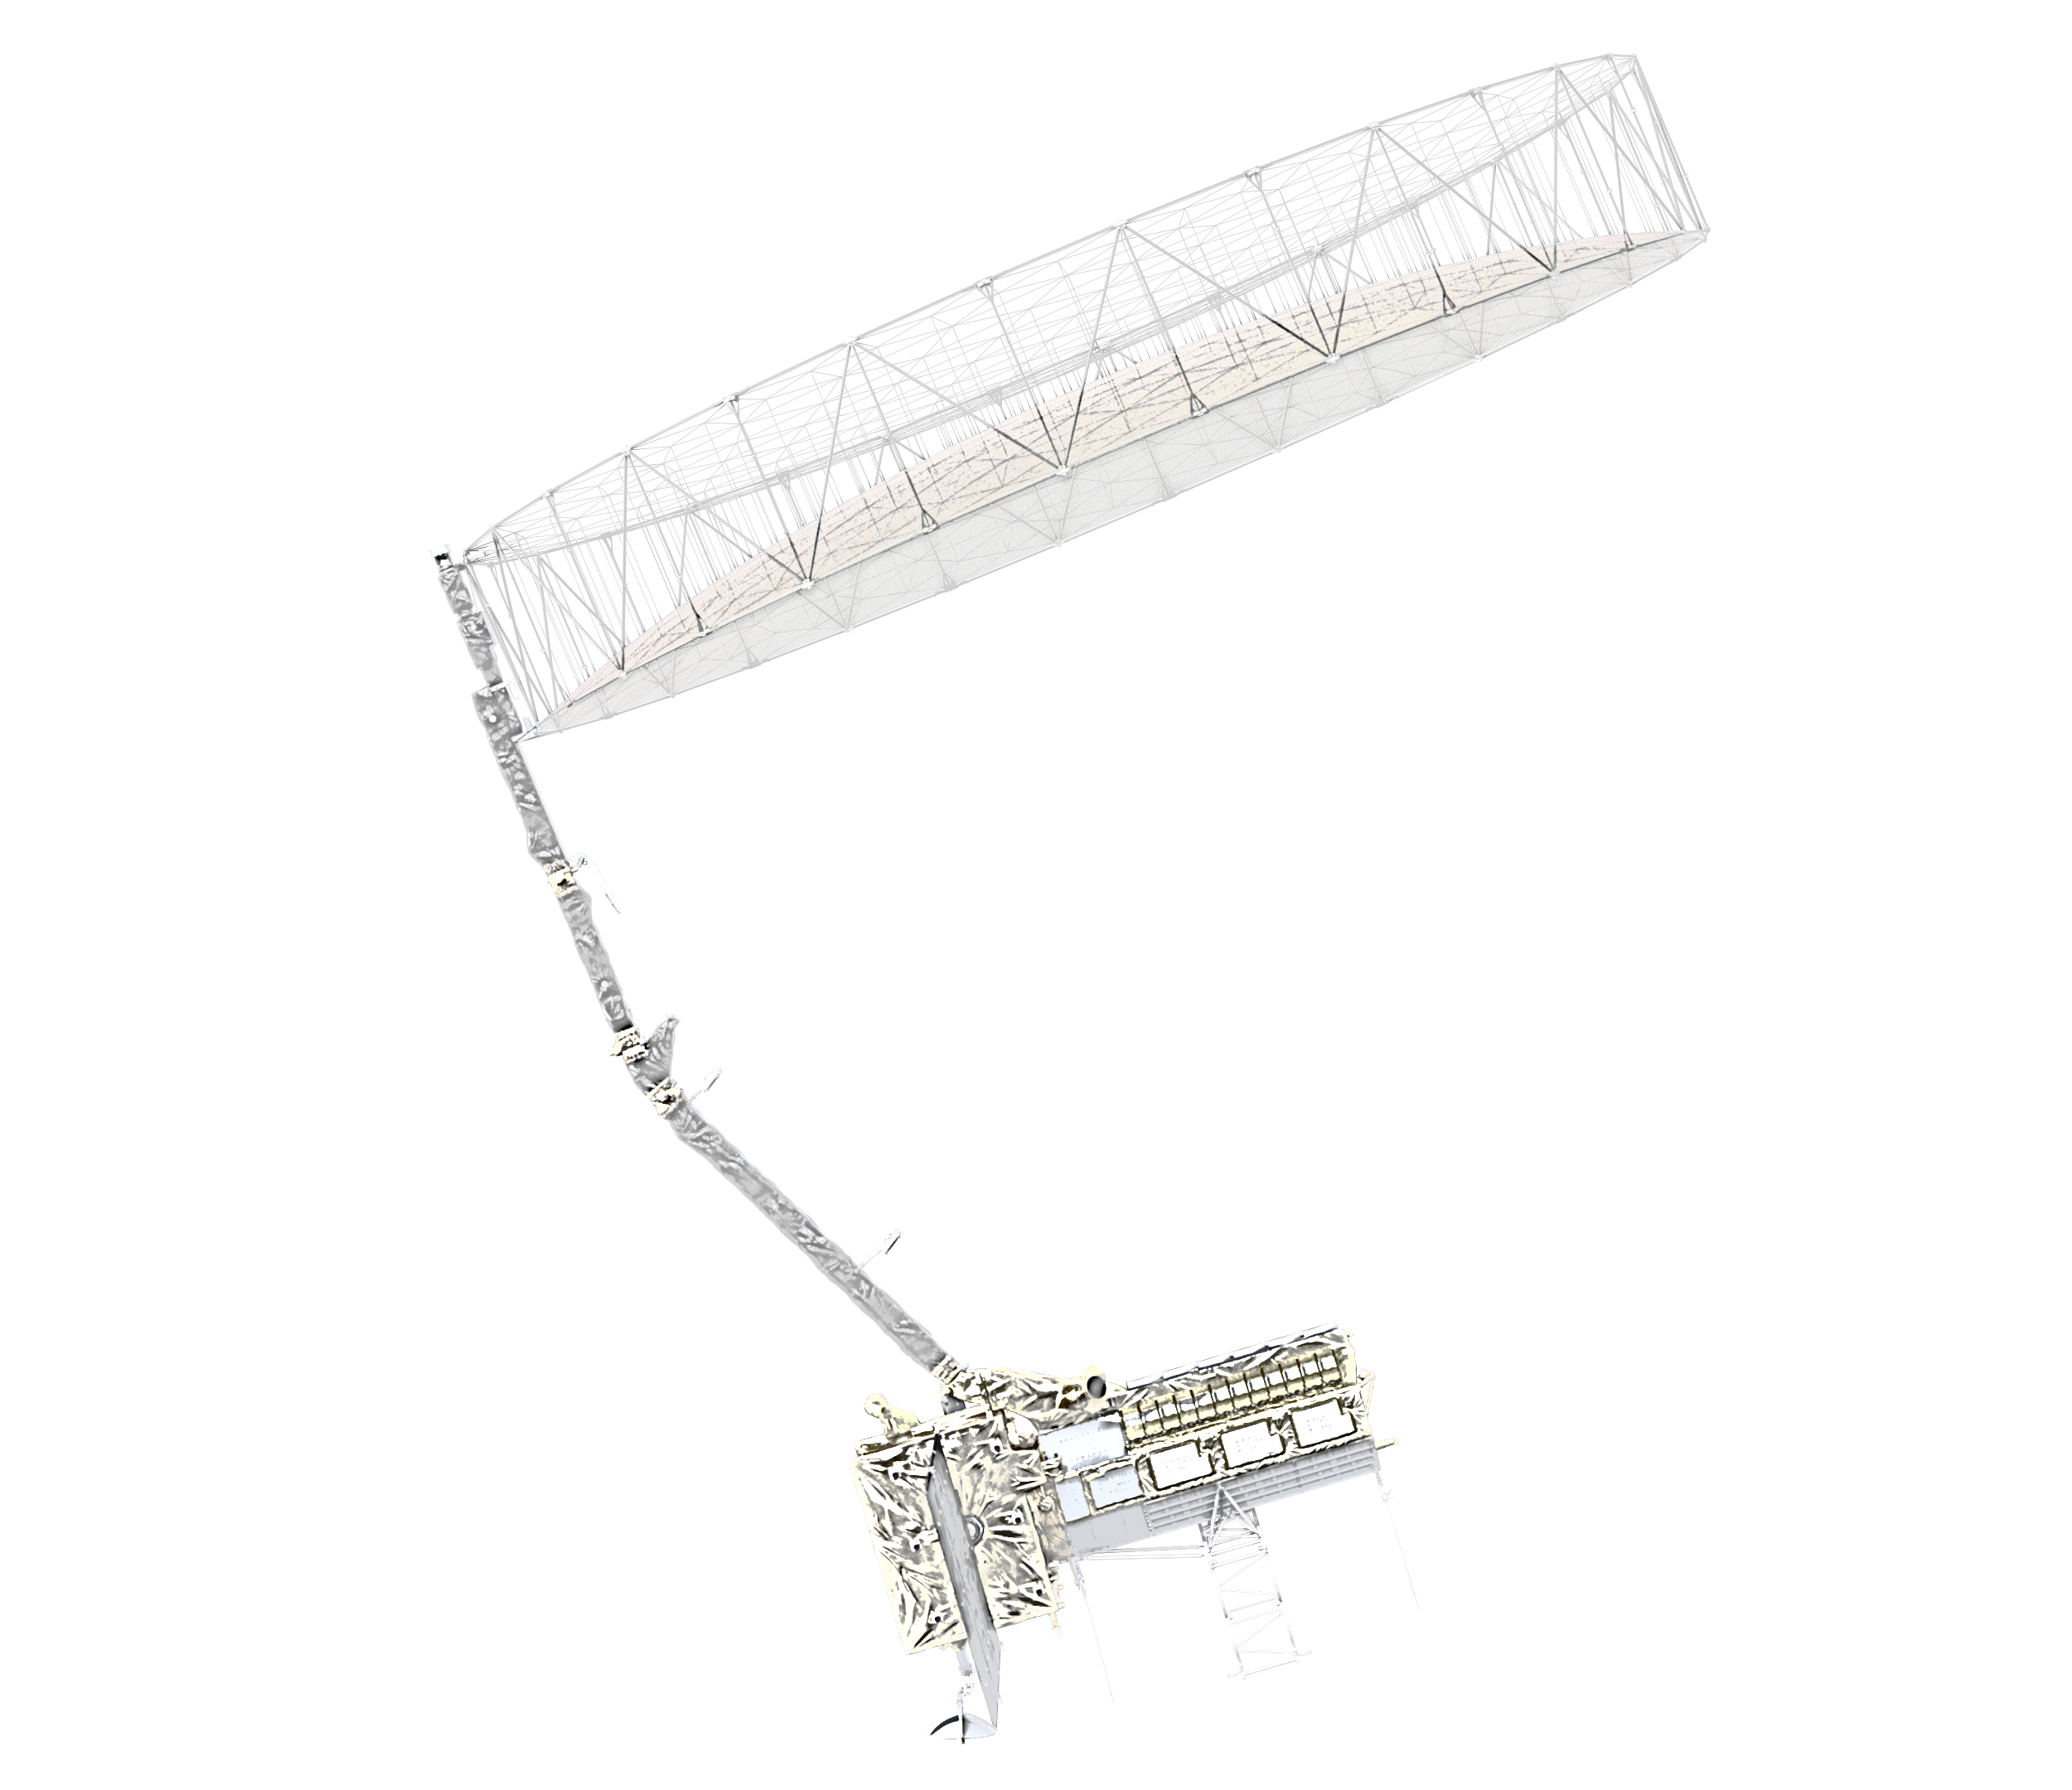
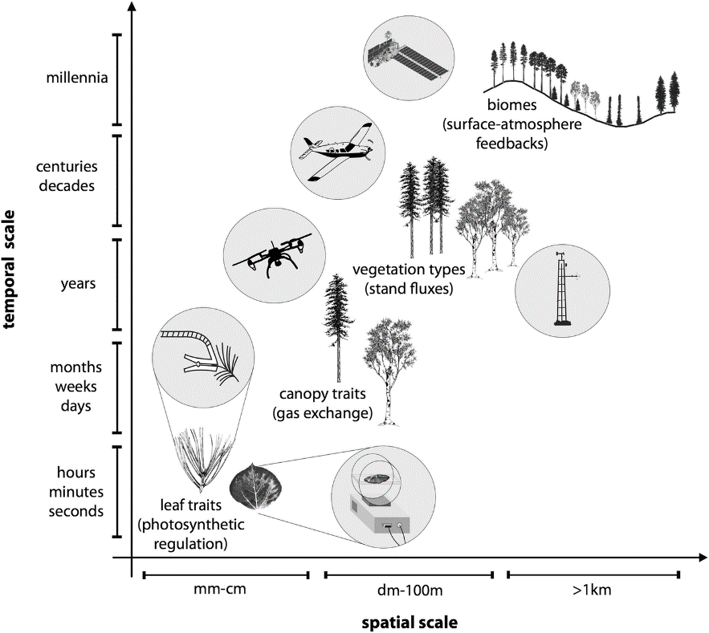
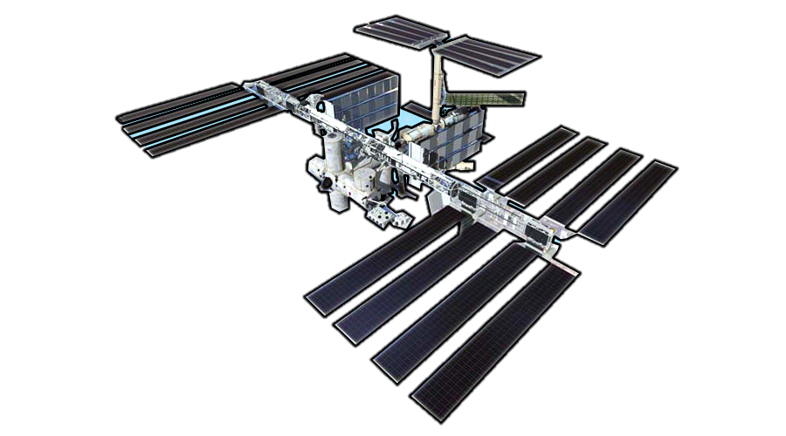
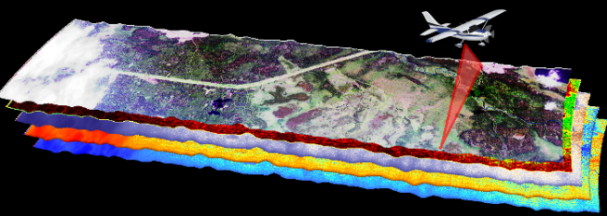
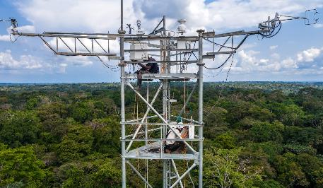
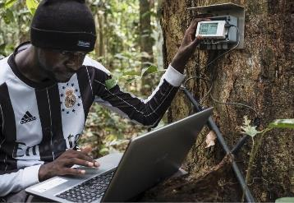
Una campaña a múltiples escalas
Interdisciplinario: Ecología, Biogeoquímica, Hidrología, Ciencias Atmosféricas, Sistemas Socioecológicos y más
Multi-escala: Observaciones en superficie, aéreas y espaciales
Créditos de la imagen: : CongoFlux, AVIRIS-NG
PANGEA - NASA Terrestrial Ecology Field Campaign Scoping Study
Notes:
Addressing these questions requires a scaling approach to link leaf, tree, and field level measurements all the way up to satellite sensors.

Slide 15
PANGEA’s 3 pilares
Ciencia: Avanzar en la comprensión científica de la región.
Formación: Capacitar a la próxima generación de científicos de la región para liderar estos esfuerzos científicos.
Vías de Acción: Mejorar las capacidades para monitorear el carbono, la biodiversidad y la agricultura utilizando sensores remotos satelitales.
PANGEA - NASA Terrestrial Ecology Field Campaign Scoping Study
Notes:
The goal of this proposed campaign is 3-fold:
Advance scientific understanding of the region
Train the next generation of scientists FROM the region to be able to lead these scientific efforts
Improve capabilities for monitoring carbon, biodiversity, and agriculture using remote sensing

Slide 16
El proceso de ‘scoping’
Solo se financiaron 2 propuestas de alcance: PANGEA y ARID
Un esfuerzo de un año para interactuar con las comunidades de investigación y profesionales con el fin de:
  Identificar prioridades y oportunidades de investigación científica
  Construir relaciones y definir metas compartidas
  Evaluar la viabilidad de la campaña
  Determinar el alcance geográfico
Entregar un documento blanco a la sede de la NASA describiendo la campaña propuesta en noviembre de 2024
Si la campaña recibe financiamiento, durará de 6 a 9 años
PANGEA - NASA Terrestrial Ecology Field Campaign Scoping Study
Notes:
We have one year to carry out this scoping process. We are spending this year defining the scientific research priorities and opportunities, engaging the research community, evaluating campaign feasibility and determining the geographic scope.
In addition to PANGEA, NASA selected one other project to scope a possible campaign, ARID, which is focused on dryland systems.
Both PANGEA and ARID will deliver white papers to NASA headquarters at the end of this year, around November. At that point, NASA will make a decision to fund one, or both, or neither of the campaigns.
The campaign that is selected will be funded for a 6- to 9-year period and will likely begin in late 2026 or early 2027 after the development of a Concise Experimental Plan.

Slide 17
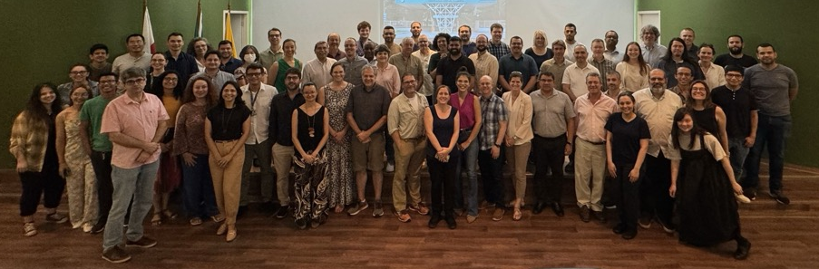
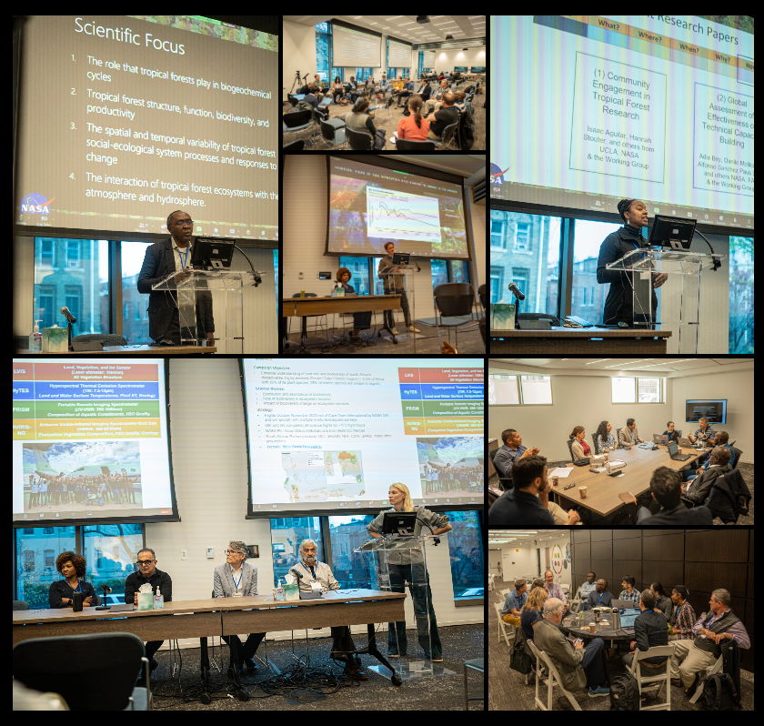
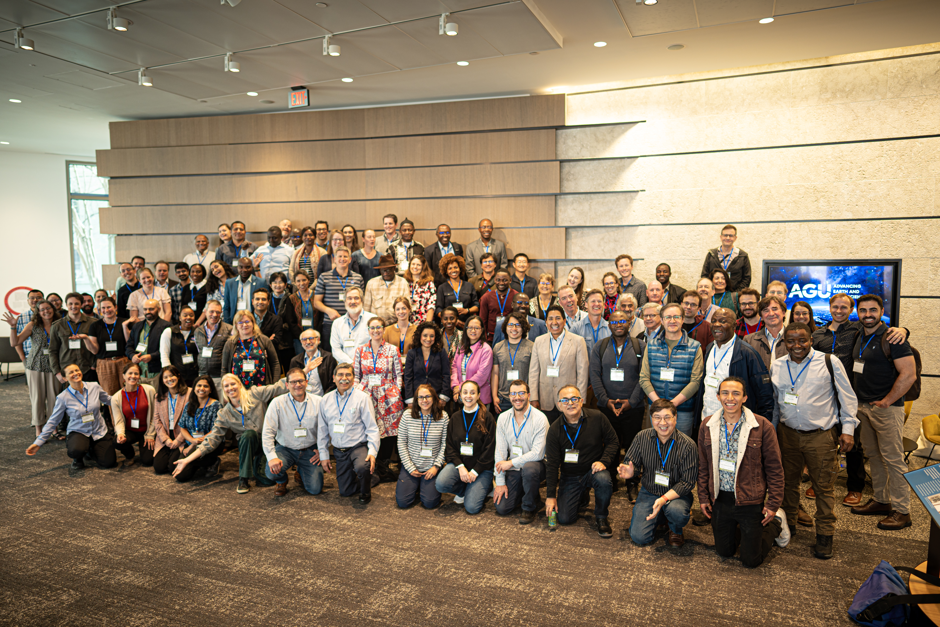
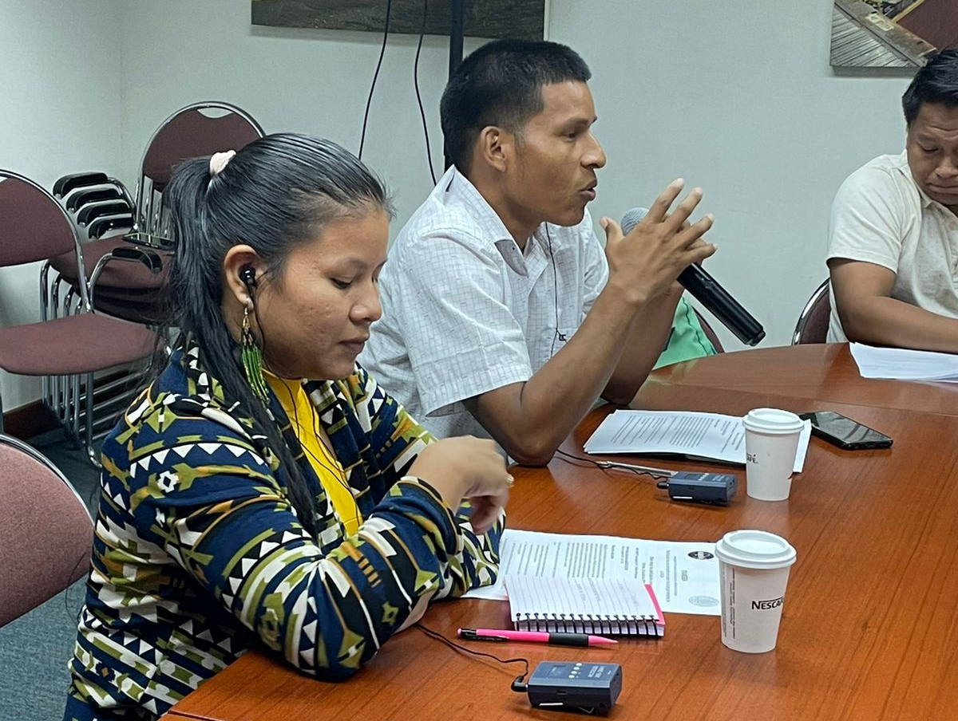
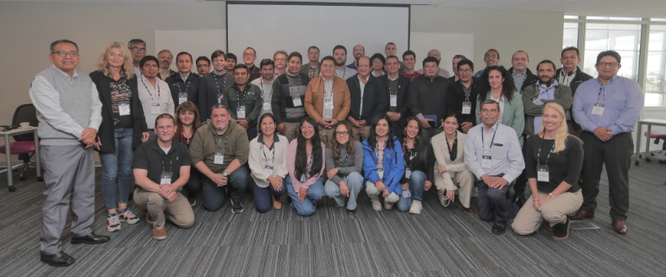
Co-producción y participación comunitaria
PANGEA - NASA Terrestrial Ecology Field Campaign Scoping Study
Notes:
In April, we held a workshop in Washington DC that included over 100 in-person participants and more than 140 participants on Zoom from over 23 countries (Brazil, Cameroon, Canada, Central African Republic, Colombia, Dem. Republic of Congo, Equatorial Guinea, Gabon, India, Indonesia, Malaysia, Panama, Peru, Puerto Rico, Nigeria, Republic of Congo, South Africa, Uganda, Belgium, France, Switzerland, UK, US). Over 50 universities and institutions were represented.
PANGEA leadership team members were recently at workshops in Thailand, Brazil, and they are currently holding a workshop in Peru, which is why they are unable to be here in person during the CBFP meeting.

Slide 18
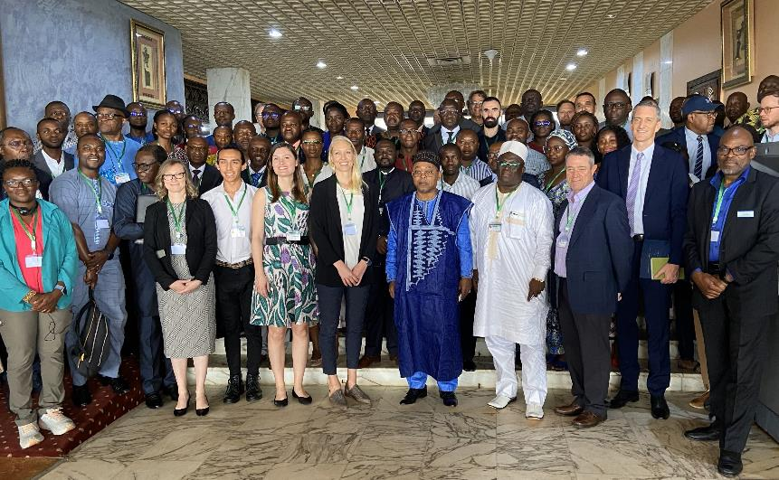
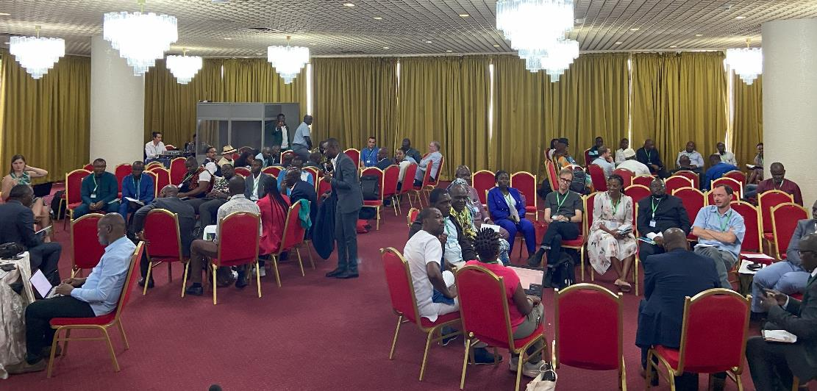

Incorporando a la comunidad de África Central
PANGEA - NASA Terrestrial Ecology Field Campaign Scoping Study
Notes:
We have also been holding workshops to engage researchers across the tropics. We had a very successful and energizing workshop in Cameroon in February with over 90 participants, primarily from Central Africa, including all Congo Basin countries, as well as participants from West, East, and South Africa. We remain engaged with many of the participants from this workshop.

Slide 19












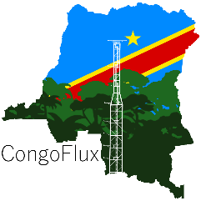
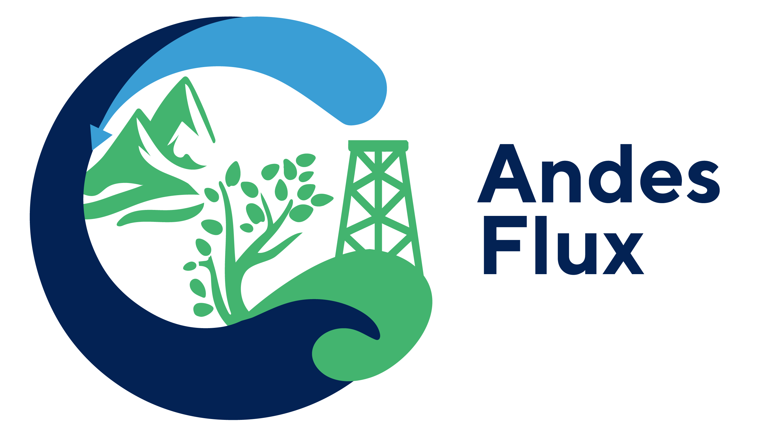







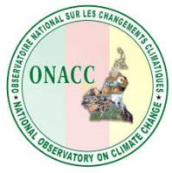


























Socios | Colaboradores
PANGEA - NASA Terrestrial Ecology Field Campaign Scoping Study

Slide 20













Líderes del Grupo de Trabajo PANGEA
Yanlei Feng
MIT
Félicien Meunier
University of Ghent
Patrick Namulisa
Columbia
Le Bien Sagang
UCLA
Hannah Stouter
UCLA
PANGEA - NASA Terrestrial Ecology Field Campaign Scoping Study
Notes:
MANY people are volunteering their time to lead our working group efforts, coordinating hundreds of people who are providing their input.

Slide 21
Grupos de trabajo
  Biogeochemical cycles & carbon dynamics
  Ecosystem structure, function, & biodiversity
  Climate feedbacks & interactions
  Socio-ecological systems
  Modeling & data synthesis
  Feasibility
  Community Engagement & Applications Output
Science Themes
Temas científicos
Cross-Cutting
Transversal
PANGEA - NASA Terrestrial Ecology Field Campaign Scoping Study

Slide 22


Esfuerzos sinérgicos
PANGEA - NASA Terrestrial Ecology Field Campaign Scoping Study
Notes:
Emphasize things that are already happening and why PANGEA is needed!
- Partnerships w ESA - AFRISAR; ASIA-AQ, Brazil campaign; Cal/val efforts for forthcoming missions; NISAR and BOMASS; CHIME and SBG
Plot networks, flux networks,
- Synergies with SERVIR & HARVEST
"One Forest Vision" Initiative (OFVi) aims to map at the tree level and to measure the carbon balance of the most vital carbon and biodiversity reserves in the Amazon, African and Asian forest basins within the next five years.
- international Scientific Advisory Board will be established (including scientific leaders from the Congo Basin Climate Science Initiative, C-TREES and GEOTREES) and will review the work plan.
At the One Forest Summit in March 2023, a declaration of intent was proposed by the scientific organisations and agencies willing to contribute to the development of the initiative.

Slide 23
Get Involved!
Involúcrate!
PANGEA Website
tinyurl.com/tropicalscoping
PANGEA - NASA Terrestrial Ecology Field Campaign Scoping Study
Notes:
With that, thank you for your attention, and please use this QR code to access our website and fill out the Get Involved form!

Slide 25






Funding Support
PANGEA - NASA Terrestrial Ecology Field Campaign Scoping Study
Notes:
I want to thank our funding support, first and foremost NASA, for selecting and funding this scoping effort.
Given the enormous task of engaging with the international research community to scope this possible campaign, we have also sought additional funding.
We are incredibly grateful to the USFS Intl Program, the Wildlife Conversation Society, the Congo Basin Institute, the Governors Forest and Climate Task Force, UCLA, the US Embassy in Cameroon, the US Embassy in the Democratic Republic of Congo, and the US Forest Service for providing funding support that made this workshop and this international scoping effort possible.
I also want to thank many of you for identifying your own funding sources that are allowing you to join us here this week. We are very appreciative. The number of people in this room is an incredible testament to the demand for a campaign that has a strong focus on African tropical forests with direct engagement of researchers from the region.

Slide 26

Exact PANGEA domain - TBD
Data source: Olson et al. 2001
PANGEA - NASA Terrestrial Ecology Field Campaign Scoping Study
Notes:
The satellite remote sensing and modeling aspects of PANGEA will be pan-tropical, although we are still actively determining the geographic scope of the coordinated data collection locations of PANGEA.

Slide 27
PANGEA – Landscape Approach
Identify candidate ‘Landscapes’ across the tropics
Locations that capture complex landscape mosaics:
  Intact, logged, degraded, and disturbed forests
  Wetlands and peatland systems
  Agroecosystems
  Mangroves (in coastal landscapes)
Coordinated ground, drone, and airborne observations
PANGEA - NASA Terrestrial Ecology Field Campaign Scoping Study
Notes:
These areas, or landscapes will be locations that encompass complex landscape mosaics including forest areas, agricultural areas, and more. We are actively gathering information on areas where existing data collection efforts and infrastructure are located, and where additional data collection should be prioritized to address PANGEA’s science questions.

